Slide 1
Data Factory
Transform data into actionable insight
Notes:
Hi, I’m ___, and I’m excited to discuss Machine Learning, and the value it can deliver to your organization.

Slide 2
Agenda
Azure Data Factory Introduction
Customer challenges
High level Azure Data Lake architecture
Activities, Pipelines
Data movement activities
Data transformation activities
Monitor & Manage
Developer tools

Slide 3
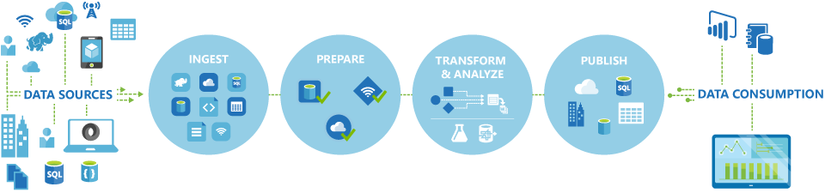
What is Azure Data Factory?
It is a cloud-based data integration service that allows you to create data-driven workflows in the cloud for orchestrating and automating data movement and data transformation
Notes:
It is a cloud-based data integration service that allows you to create data-driven workflows in the cloud for orchestrating and automating data movement and data transformation. Using Azure Data Factory, you can create and schedule data-driven workflows (called pipelines) that can ingest data from disparate data stores, process/transform the data by using compute services such as Azure HDInsight Hadoop, Spark, Azure Data Lake Analytics, and Azure Machine Learning, and publish output data to data stores such as Azure SQL Data Warehouse for business intelligence (BI) applications to consume. +
It's more of an Extract-and-Load (EL) and then Transform-and-Load (TL) platform rather than a traditional Extract-Transform-and-Load (ETL) platform. The transformations that are performed are to transform/process data by using compute services rather than to perform transformations like the ones for adding derived columns, counting number of rows, sorting data, etc. +
Currently, in Azure Data Factory, the data that is consumed and produced by workflows is time-sliced data (hourly, daily, weekly, etc.). For example, a pipeline may read input data, process data, and produce output data once a day. You can also run a workflow just one time.

Slide 4
How does it work?
Connect and collect
You can use the Copy Activity in a data pipeline to move data from both on-premises and cloud source data stores to a centralization data store in the cloud for further analysis
Transform and enrich
Process through HDInsight Hadoop, Spark, Data Lake Analytics, and Machine Learning.
Publish
Deliver transformed data from the cloud to on-premises sources like SQL Server, or keep it in your cloud storage sources for consumption by business intelligence (BI) and analytics tools and other applications.
Notes:
Connect and collect
Enterprises have data of various types located in disparate sources. The first step in building an information production system is to connect to all the required sources of data and processing, such as SaaS services, file shares, FTP, web services, and move the data as-needed to a centralized location for subsequent processing.+
Without Data Factory, enterprises must build custom data movement components or write custom services to integrate these data sources and processing. It is expensive and hard to integrate and maintain such systems, and it often lacks the enterprise grade monitoring and alerting, and the controls that a fully managed service can offer.+
With Data Factory, you can use the Copy Activity in a data pipeline to move data from both on-premises and cloud source data stores to a centralization data store in the cloud for further analysis. For example, you can collect data in an Azure Data Lake Store and transform the data later by using an Azure Data Lake Analytics compute service. Or, collect data in an Azure Blob Storage and transform data later by using an Azure HDInsight Hadoop cluster.
Transform and enrich
Once data is present in a centralized data store in the cloud, you want the collected data to be processed or transformed by using compute services such as HDInsight Hadoop, Spark, Data Lake Analytics, and Machine Learning. You want to reliably produce transformed data on a maintainable and controlled schedule to feed production environments with trusted data. +
Publish
Deliver transformed data from the cloud to on-premises sources like SQL Server, or keep it in your cloud storage sources for consumption by business intelligence (BI) and analytics tools and other applications.

Slide 5
4 Key components
Activities
Actions you perform on your data
Inputs turned into outputs
Pipelines
Logical grouping of activities for group operations
Data sets
A named reference/pointer to data you want to use as an input or output of an activity
Linked services
Connection of data factories to the resources and services you want to use
Connection of data stores like Azure storage and on-premises SQL Server
Connection of compute services like Azure Machine Learning, Azure HDInsight, and Azure Batch
Transform data into actionable intelligence
AZURE DATA FACTORY
Manage and monitor
Data and operational lineage
Coordination and scheduling
Policy
DATA PIPELINES
Processing activity
Processing activity
Raw data
Orchestration and monitoring
Information
assets
LINKED SERVICES:
Data stores
Data processing
Data stores
Relational and non-relational
On-premises or cloud
Hadoop (Hive, Pig, etc.)
Custom code
Data movement
Azure Machine Learning
Range of data stores
Consumed by BI app
Notes:
Lets look at the relationships between data set, activity, pipeline, and linked service.
Talking Points:
Activities Activities define the actions to perform on your data. Each activity takes zero or more data sets as inputs and produces one or more data sets as outputs. An activity is a unit of orchestration in Azure Data Factory. For example, you may use a Copy activity to orchestrate copying data from one data set to another. Similarly you may use a Hive activity that will run a Hive query on an Azure HDInsight cluster to transform or analyze your data. Azure Data Factory provides a wide range of data transformation, analysis, and data movement activities.
Pipelines Pipelines are a logical grouping of activities. They are used to group activities into a unit that together perform a task. For example, a sequence of several transformation activities might be needed to cleanse log file data. This sequence could have a complex schedule and dependencies that need to be orchestrated and automated. All of these activities could be grouped into a single pipeline named “CleanLogFiles.” “CleanLogFiles” could then be deployed, scheduled, or deleted as one single unit instead of managing each individual activity independently.
Data sets
Data sets are named references/pointers to the data you want to use as an input or an output of an activity. Data sets identify data structures within different data stores including tables, files, folders, and documents.
Linked services
Linked services define the information needed for Data Factory to connect to external resources. Linked services are used for two purposes in Data Factory:
To represent a data store including, but not limited to, an on-premises SQL Server, Oracle DB, file share, or an Azure Blob storage account.
To represent a compute resource that can host the execution of an activity.
With the four simple concepts of data sets, activities, pipelines, and linked services, you are ready to get started! You can build your first pipeline from the ground up, or deploy a ready-made sample by following the instructions in our Data Factory samples article.

Slide 6
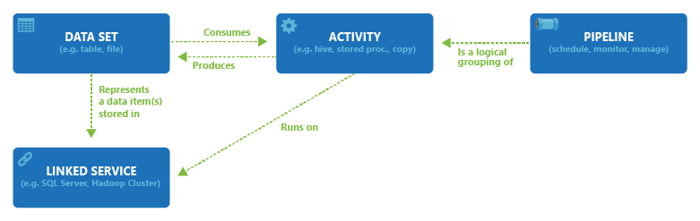
Relationship between Data Factory entities
Transform data into actionable intelligence
Notes:
Azure Data Factory itself does not store any data. It lets you create data-driven workflows to orchestrate movement of data between supported data stores and processing of data using compute services in other regions or in an on-premises environment. It also allows you to monitor and manage workflows using both programmatic and UI mechanisms.+
Even though Data Factory is available in only West US, East US, and North Europe regions, the service powering the data movement in Data Factory is available globally in several regions. If a data store is behind a firewall, then a Data Management Gateway installed in your on-premises environment moves the data instead.

Slide 7




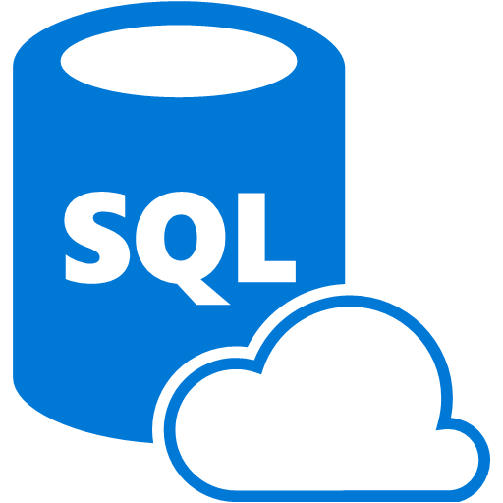
Data Factory Concepts
Data set
(Collection of files, DB table, etc.)
Activity: A processing step
(Hadoop job, custom code, ML model, etc.)
Pipeline: A sequence of
activities (logical group)
…
Data sources
Ingest
Transform and analyze
Publish
Customer web logs
Customer web Logs
Transform, combine, etc.
Analyze
Move
Visualize
Product table
Product table
On-premises
data mart
Combined input table
Mapping
Product recommendations
Azure Blob storage
Azure DB
Notes:
Objective: A platform for developers to compose data processing, storage, and movement services into operationalized analytics pipelines that protect the trusted information assets you can manage and monitor from one place.
Enables operationalization of data processing across diverse data and processing environments (SaaS, on-premises and cloud).
Provides management and monitoring at scale (processing and data lifecycle).
Integrates information production directly with consumption/discovery experiences.
Talking Points:
<<animation>> <click>
There are many data sources from which you require data, such as an on-premises source, a cloud source, an SaaS source, etc. <click>
Usually what you’re doing is ingesting data into a data hub of persistent storage that has compute resources co-located with it.<click>
We make it easy to ingest data into the storage side of the hub, automate processing of data in the hub, and then move data among hubs.
Data Factory gives you a general view of the tools you have to build analytic pipelines that compose data storage, data processing, and data movement that you can monitor and manage from one place.
Azure data Factory provides:
processing by using the likes of Hadoop (Pig, Hive, and M/R) , Data Lake Analytics, Machine Learning and custom C# code.
data stores are SQL DB, Azure Blobs, Azure Tables, and SQL Server (on-premises and IaaS) to name a few. <click>
Provides the output for Presentation to other apps or BI systems. <click>
Looking at the different services you see how the interact.
In the future, we may add more third-party heterogeneous data store connectors, hubs, and activities. If you have feedback on which to prioritize, let us know.
A concrete example of this is Skype and Xbox, which have on-premises warehouses to understand who bought what, where and when. We have logs tracking how often you used Skype and what your experience was. Often we want to combine this to understand if you’re a new Skype user and what your first week’s experience was like. If it’s not great, we want to drive a list of these customers to a marketing data mart for use in a campaign and then operationalize this flow.
We’re not saying that all data has to be stored or moved into Azure. The vision for Data Factory is to give you a monitoring and management console of composite data pipelines, where all data could be stored and processed on-premises, in the cloud, or both.

Slide 8
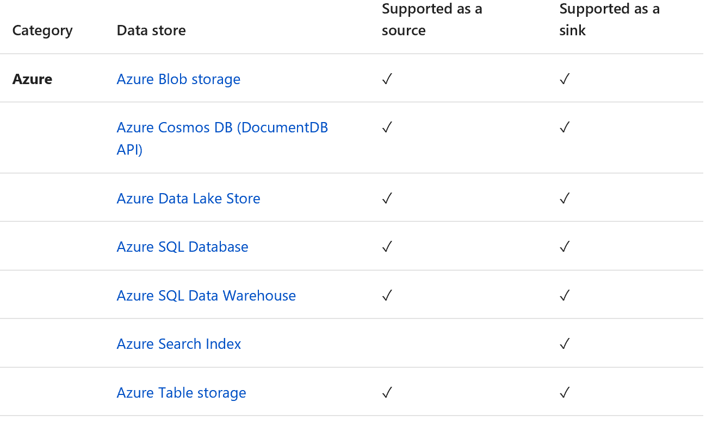
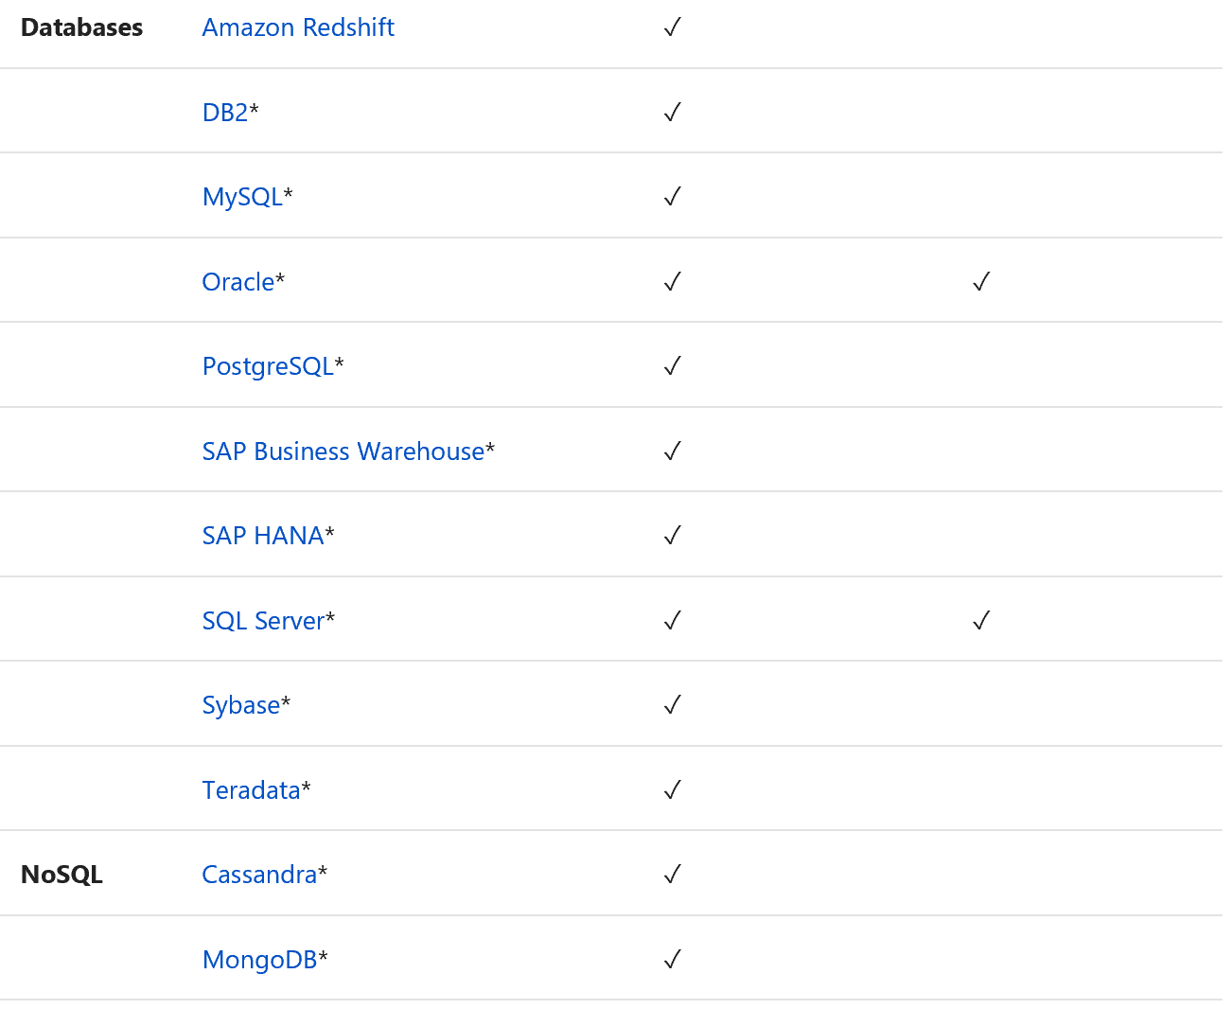
Data movement activities

Slide 9
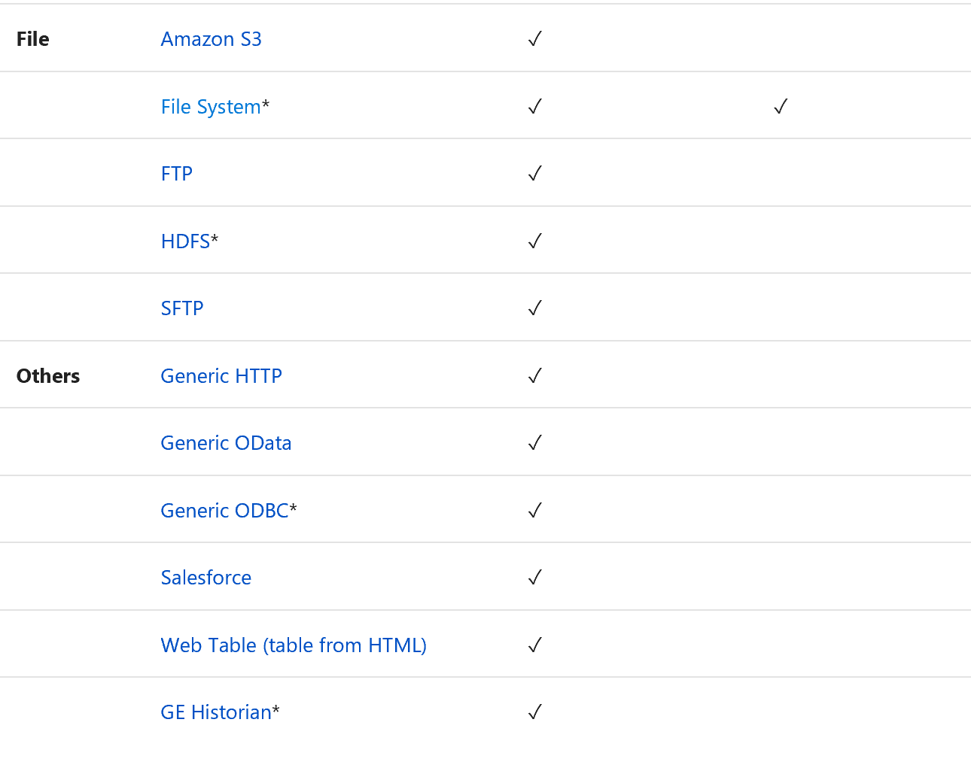
Data movement activities

Slide 10
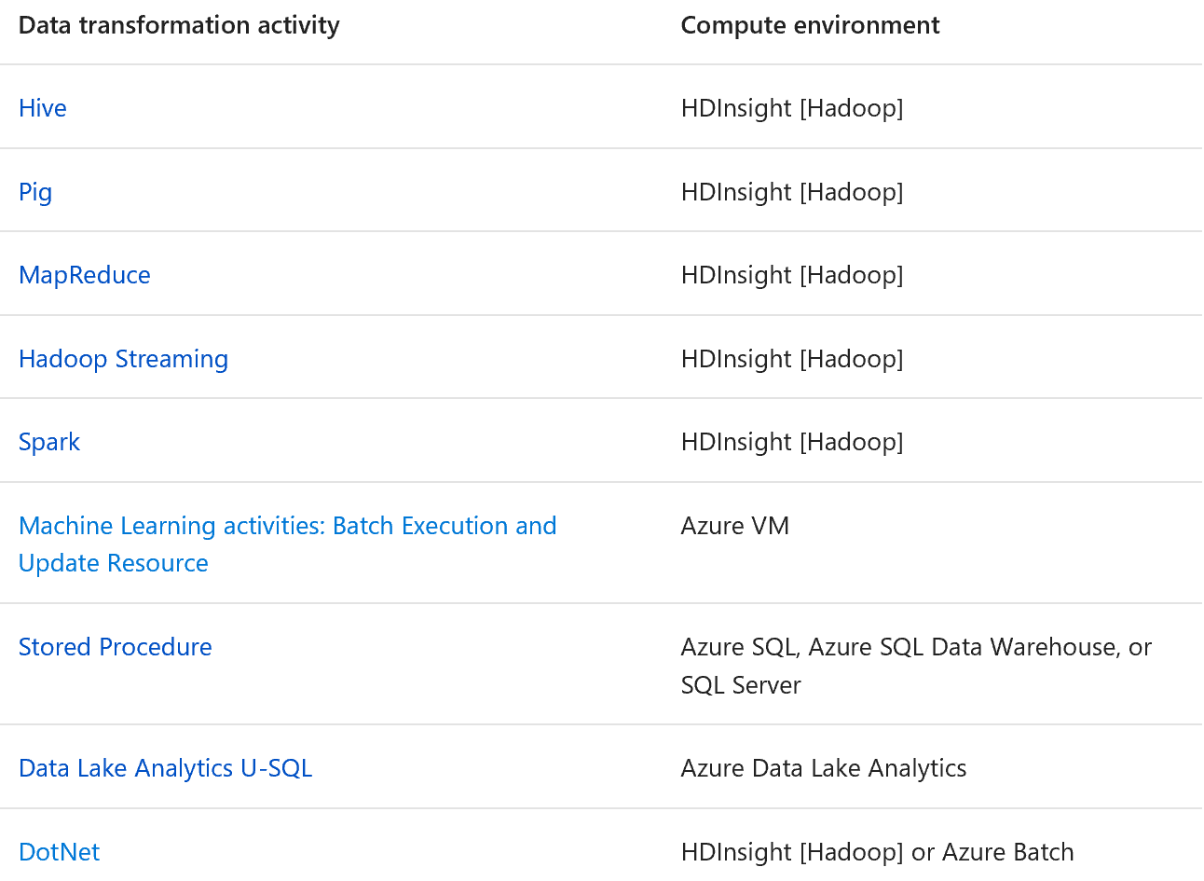
Data transformation activities

Slide 11
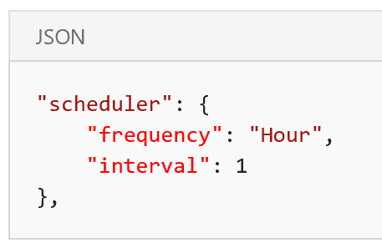
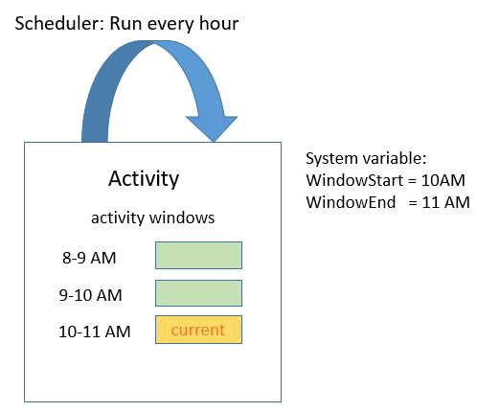
Specify schedule for an activity
It is not the pipeline that is executed. It is the activities in the pipeline that are executed in the overall context of the pipeline. You can specify a recurring schedule for an activity by using the scheduler section of activity JSON
As shown in the following diagram, specifying a schedule for an activity creates a series of tumbling windows with in the pipeline start and end times. Tumbling windows are a series of fixed-size non-overlapping, contiguous time intervals. These logical tumbling windows for an activity are called activity windows.

Slide 12
Copy Activity
You can do the following copy activities:
Copy data in on-premises SQL Server and write to Azure Data Lake Store in ORC format.
Copy files in text (CSV) format from on-premises File System and write to Azure Blob in Avro format.
Copy zipped files from on-premises File System and decompress then land to Azure Data Lake Store.
Copy data in GZip compressed text (CSV) format from Azure Blob and write to Azure SQL Database.
Copy Activity also reads from and writes to files in specified formats: Text, JSON, Avro, ORC, and Parquet, and compression codec GZip, Deflate, BZip2, and ZipDeflate are supported

Slide 13
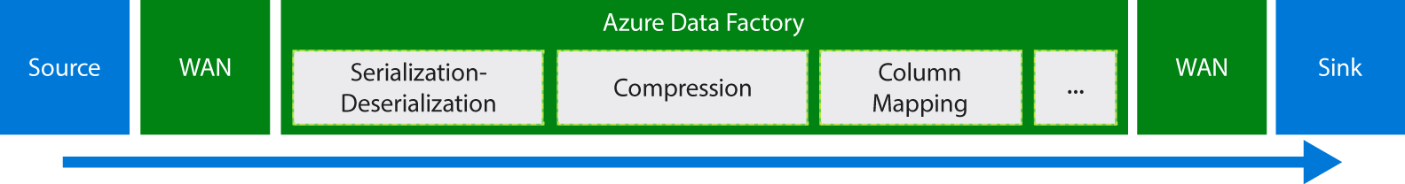
Move data by using Copy Activity
Copy data between two cloud data stores
Reads data from the source data store.
Performs serialization/deserialization, compression/decompression, column mapping, and type conversion. It does these operations based on the configurations of the input dataset, output dataset, and Copy Activity.
Writes data to the destination data store.
The service automatically chooses the optimal region to perform the data movement. This region is usually the one closest to the sink data store.

Slide 14
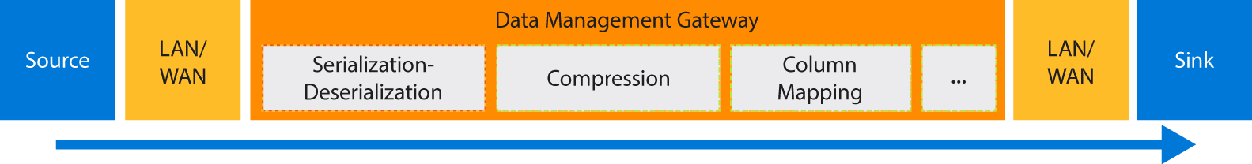
Move data by using Copy Activity
Copy data between an on-premises data store and a cloud data store
In this scenario, Data Management Gateway performs the serialization/deserialization, compression/decompression, column mapping, and type conversion. Data does not flow through the Azure Data Factory service. Instead, Data Management Gateway directly writes the data to the destination store.

Slide 15
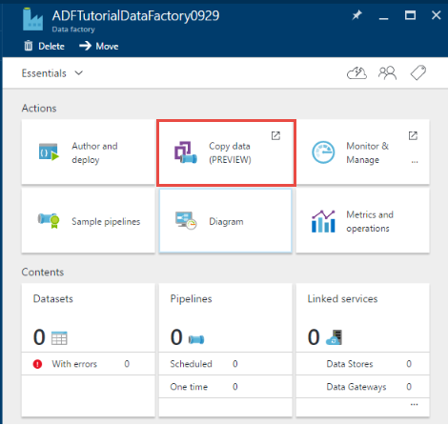
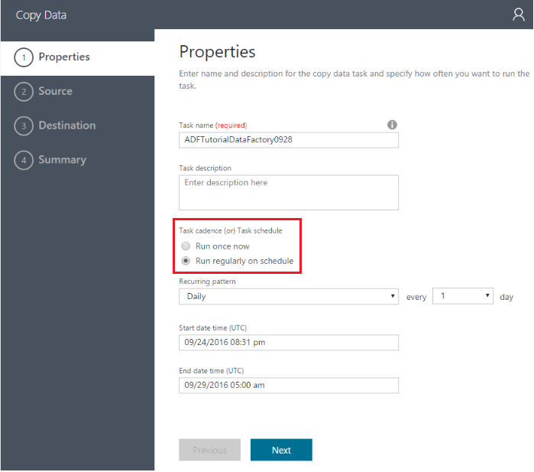
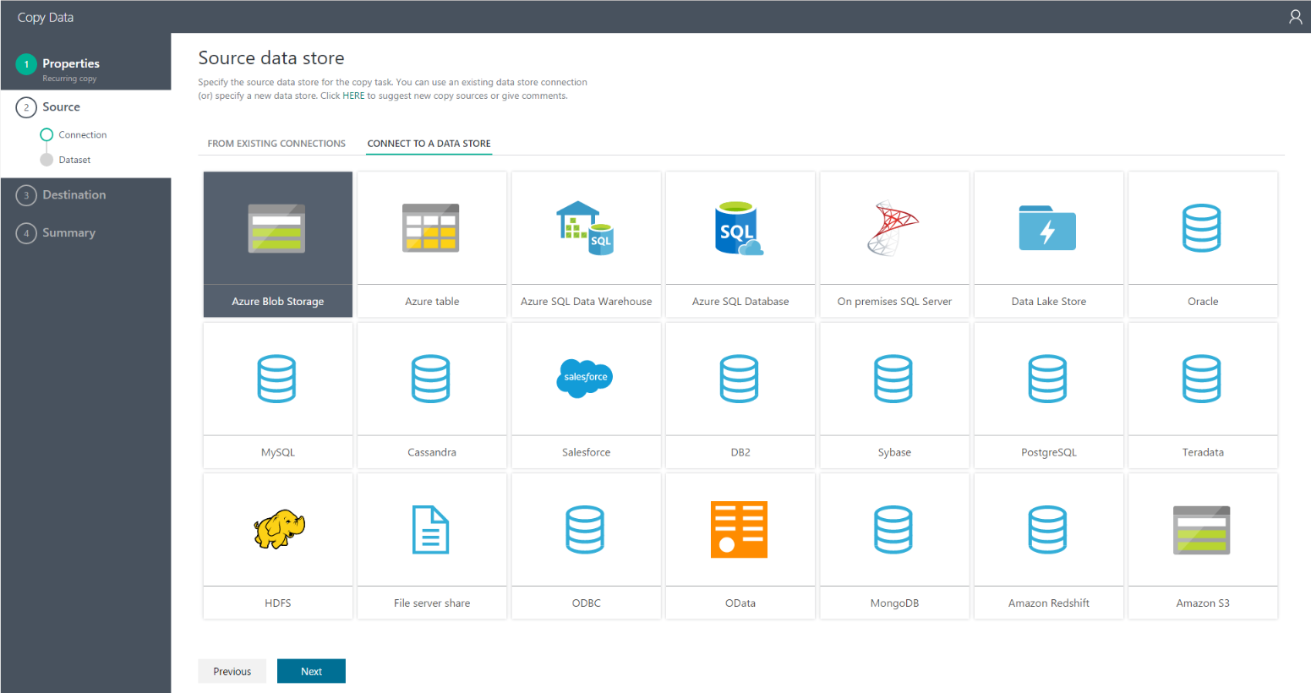
Azure Data Factory Copy Wizard
Notes:
The Azure Data Factory Copy Wizard eases the process of ingesting data, which is usually a first step in an end-to-end data integration scenario. When going through the Azure Data Factory Copy Wizard, you do not need to understand any JSON definitions for linked services, data sets, and pipelines. The wizard automatically creates a pipeline to copy data from the selected data source to the selected destination. In addition, the Copy Wizard helps you to validate the data being ingested at the time of authoring. This saves time, especially when you are ingesting data for the first time from the data source. To start the Copy Wizard, click the Copy data tile on the home page of your data factory.
Designed for big data
This wizard allows you to easily move data from a wide variety of sources to destinations in minutes. After you go through the wizard, a pipeline with a copy activity is automatically created for you, along with dependent Data Factory entities (linked services and data sets). No additional steps are required to create the pipeline.
The wizard is designed with big data in mind from the start, with support for diverse data and object types. You can author Data Factory pipelines that move hundreds of folders, files, or tables. The wizard supports automatic data preview, schema capture and mapping, and data filtering.
Automatic data preview
You can preview part of the data from the selected data source in order to validate whether the data is what you want to copy. In addition, if the source data is in a text file, the Copy Wizard parses the text file to learn the row and column delimiters and schema automatically.
Schema capture and mapping
The schema of input data may not match the schema of output data in some cases. In this scenario, you need to map columns from the source schema to columns from the destination schema.
Use a drop-down list to select a column from the source schema to map to a column in the destination schema. The Copy Wizard tries to understand your pattern for column mapping. It applies the same pattern to the rest of the columns, so that you do not need to select each of the columns individually to complete the schema mapping. If you prefer, you can override these mappings by using the drop-down lists to map the columns one by one. The pattern becomes more accurate as you map more columns. The Copy Wizard constantly updates the pattern, and ultimately reaches the right pattern for the column mapping you want to achieve.
Filtering data
You can filter source data to select only the data that needs to be copied to the sink data store. Filtering reduces the volume of the data to be copied to the sink data store and therefore enhances the throughput of the copy operation. It provides a flexible way to filter data in a relational database by using the SQL query language, or files in an Azure blob folder by using Data Factory functions and variables.
Scheduling options
You can run the copy operation once or on a schedule (hourly, daily, and so on). Both of these options can be used for the breadth of the connectors across environments, including on-premises, cloud, and local desktop copy.+
A one-time copy operation enables data movement from a source to a destination only once. It applies to data of any size and any supported format. The scheduled copy allows you to copy data on a prescribed recurrence. You can use rich settings (like retry, timeout, and alerts) to configure the scheduled copy.

Slide 16
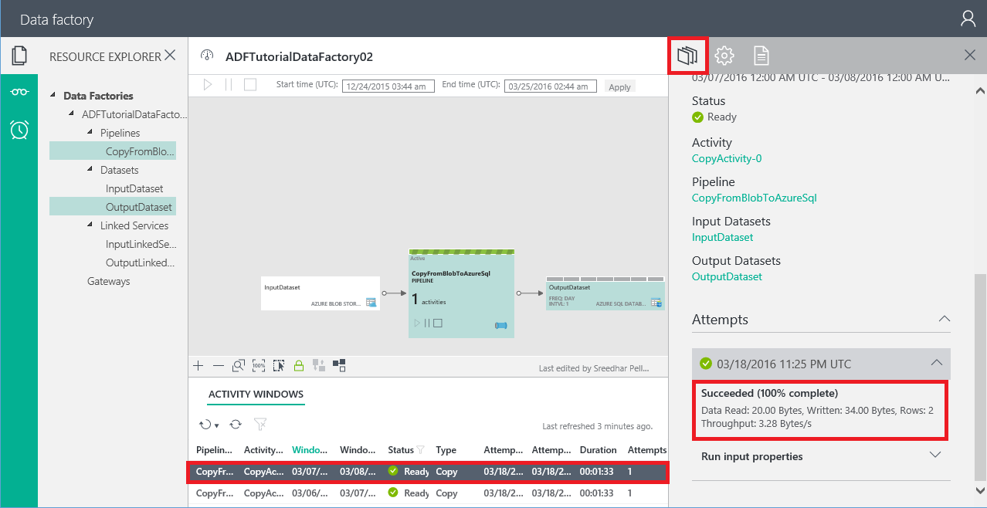
Performance tuning steps
We suggest that you take these steps to tune the performance of your Data Factory service with Copy Activity:
1. Establish a baseline. During the development phase, test your pipeline by using Copy Activity against a representative data sample. You can use the Data Factory slicing model to limit the amount of data you work with. Collect execution time and performance characteristics by using the Monitoring and Management App.
2. Diagnose and optimize performance. Performance features:
Parallel copy
Cloud data movement units
Staged copy
Source
Sink
Serialization and deserialization
Compression
Column mapping
Data Management Gateway
Other considerations
3. Expand the configuration to your entire data set.

Slide 17
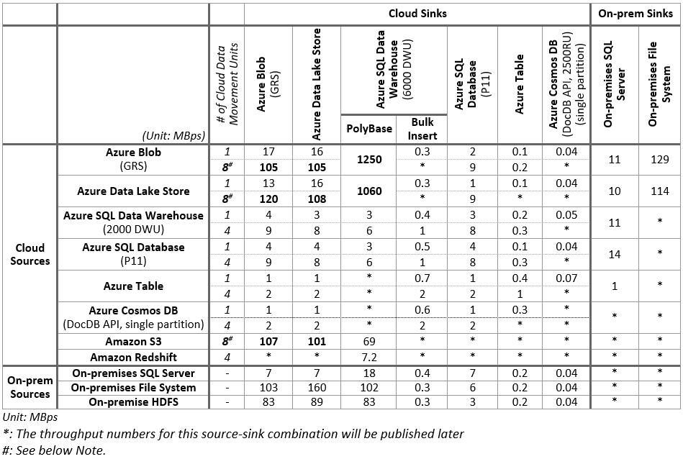
Copy Activity performance and tuning guide
Azure provides a set of enterprise-grade data storage and data warehouse solutions, and Copy Activity offers a highly optimized data loading experience that is easy to configure and set up. With just a single copy activity, you can achieve:
Loading data into Azure SQL Data Warehouse at 1.2 GBps. (Load 1 TB into Azure SQL Data Warehouse under 15 minutes with Azure Data Factory)
Loading data into Azure Blob storage at 1.0 GBps
Loading data into Azure Data Lake Store at 1.0 GBps
Notes:
Points to note:+
Throughput is calculated by using the following formula: [size of data read from source]/[Copy Activity run duration].
The performance reference numbers in the table were measured using TPC-H data set in a single copy activity run.
To copy between cloud data stores, set cloudDataMovementUnits to 1 and 4 (or 8) for comparison. parallelCopies is not specified. See the Parallel copy section for details about these features.
In Azure data stores, the source and sink are in the same Azure region.
For hybrid (on-premises to cloud, or cloud to on-premises) data movement, a single instance of gateway was running on a machine that was separate from the on-premises data store. The configuration is listed in the next table. When a single activity was running on gateway, the copy operation consumed only a small portion of the test machine's CPU, memory, or network bandwidth. CPU32 cores 2.20 GHz Intel Xeon E5-2660 v2Memory128 GBNetworkInternet interface: 10 Gbps; intranet interface: 40 Gbps

Slide 18
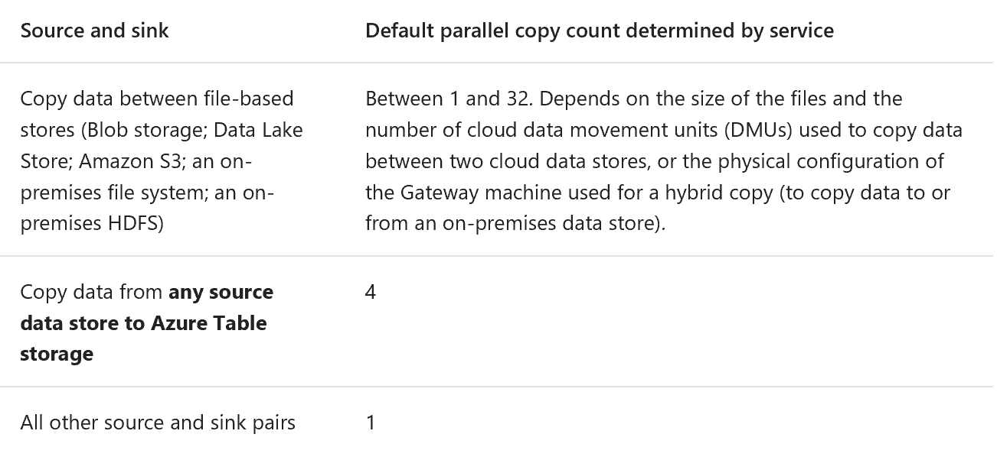
Parallel Copy
You can use the parallelCopies property to indicate the parallelism that you want Copy Activity to use. You can think of this property as the maximum number of threads within Copy Activity that can read from your source or write to your sink data stores in parallel.
Notes:
You can use the parallelCopies property to indicate the parallelism that you want Copy Activity to use. You can think of this property as the maximum number of threads within Copy Activity that can read from your source or write to your sink data stores in parallel.+
For each Copy Activity run, Data Factory determines the number of parallel copies to use to copy data from the source data store and to the destination data store. The default number of parallel copies that it uses depends on the type of source and sink that you are using.
Points to note:+
When you copy data between file-based stores, the parallelCopies determine the parallelism at the file level. The chunking within a single file would happen underneath automatically and transparently, and it's designed to use the best suitable chunk size for a given source data store type to load data in parallel and orthogonal to parallelCopies. The actual number of parallel copies the data movement service uses for the copy operation at run time is no more than the number of files you have. If the copy behavior is mergeFile, Copy Activity cannot take advantage of file-level parallelism.
When you specify a value for the parallelCopies property, consider the load increase on your source and sink data stores, and to gateway if it is a hybrid copy. This happens especially when you have multiple activities or concurrent runs of the same activities that run against the same data store. If you notice that either the data store or Gateway is overwhelmed with the load, decrease the parallelCopies value to relieve the load.
When you copy data from stores that are not file-based to stores that are file-based, the data movement service ignores the parallelCopies property. Even if parallelism is specified, it's not applied in this case.
Notes:
You can read data from the source or write data to the destination in parallel within a Copy Activity run. This feature enhances the throughput of a copy operation and reduces the time it takes to move data.+
This setting is different from the concurrency property in the activity definition. The concurrency property determines the number of concurrent Copy Activity runs to process data from different activity windows (1 AM to 2 AM, 2 AM to 3 AM, 3 AM to 4 AM, and so on). This capability is helpful when you perform a historical load. The parallel copy capability applies to a single activity run.+
Let's look at a sample scenario. In the following example, multiple slices from the past need to be processed. Data Factory runs an instance of Copy Activity (an activity run) for each slice:+
The data slice from the first activity window (1 AM to 2 AM) ==> Activity run 1
The data slice from the second activity window (2 AM to 3 AM) ==> Activity run 2
The data slice from the second activity window (3 AM to 4 AM) ==> Activity run 3
+
And so on.+
In this example, when the concurrency value is set to 2, Activity run 1 and Activity run 2 copy data from two activity windows concurrently to improve data movement performance. However, if multiple files are associated with Activity run 1, the data movement service copies files from the source to the destination one file at a time.

Slide 19
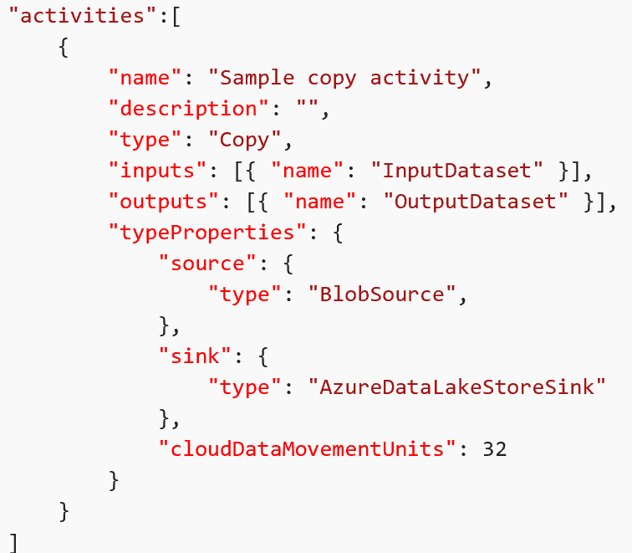
Cloud data movement units
A cloud data movement unit (DMU) is a measure that represents the power (a combination of CPU, memory, and network resource allocation) of a single unit in Data Factory. A DMU might be used in a cloud-to-cloud copy operation, but not in a hybrid copy.
The allowed values for the cloudDataMovementUnits property are 1 (default), 2, 4, 8, 16, 32. The actual number of cloud DMUs that the copy operation uses at run time is equal to or less than the configured value, depending on your data pattern.
If you need more cloud DMUs for a higher throughput, contact Azure support. Setting of 8 and above currently works only when you copy multiple files from Blob storage/Data Lake Store/Amazon S3/cloud FTP/cloud SFTP to Blob storage/Data Lake Store/Azure SQL Database.
Notes:
A cloud data movement unit (DMU) is a measure that represents the power (a combination of CPU, memory, and network resource allocation) of a single unit in Data Factory. A DMU might be used in a cloud-to-cloud copy operation, but not in a hybrid copy.+
By default, Data Factory uses a single cloud DMU to perform a single Copy Activity run. To override this default, specify a value for the cloudDataMovementUnits property as follows. For information about the level of performance gain you might get when you configure more units for a specific copy source and sink, see the performance reference.

Slide 20
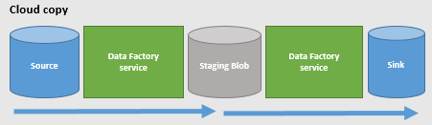
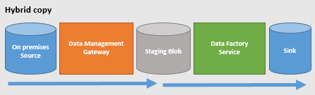
Staged copy
When you copy data from a source data store to a sink data store, you might choose to use Blob storage as an interim staging store. Staging is especially useful in the following cases:
You want to ingest data from various data stores into SQL Data Warehouse via PolyBase.
Sometimes it takes a while to perform a hybrid data movement (that is, to copy between an on-premises data store and a cloud data store) over a slow network connection.
You don't want to open ports other than port 80 and port 443 in your firewall, because of corporate IT policies.
Notes:
When you copy data from a source data store to a sink data store, you might choose to use Blob storage as an interim staging store. Staging is especially useful in the following cases:+
You want to ingest data from various data stores into SQL Data Warehouse via PolyBase. SQL Data Warehouse uses PolyBase as a high-throughput mechanism to load a large amount of data into SQL Data Warehouse. However, the source data must be in Blob storage, and it must meet additional criteria. When you load data from a data store other than Blob storage, you can activate data copying via interim staging Blob storage. In that case, Data Factory performs the required data transformations to ensure that it meets the requirements of PolyBase. Then it uses PolyBase to load data into SQL Data Warehouse. For more details, see Use PolyBase to load data into Azure SQL Data Warehouse. For a walkthrough with a use case, see Load 1 TB into Azure SQL Data Warehouse under 15 minutes with Azure Data Factory.
Sometimes it takes a while to perform a hybrid data movement (that is, to copy between an on-premises data store and a cloud data store) over a slow network connection. To improve performance, you can compress the data on-premises so that it takes less time to move data to the staging data store in the cloud. Then you can decompress the data in the staging store before you load it into the destination data store.
You don't want to open ports other than port 80 and port 443 in your firewall, because of corporate IT policies. For example, when you copy data from an on-premises data store to an Azure SQL Database sink or an Azure SQL Data Warehouse sink, you need to activate outbound TCP communication on port 1433 for both the Windows firewall and your corporate firewall. In this scenario, take advantage of the gateway to first copy data to a Blob storage staging instance over HTTP or HTTPS on port 443. Then, load the data into SQL Database or SQL Data Warehouse from Blob storage staging. In this flow, you don't need to enable port 1433.
How staged copy works
When you activate the staging feature, first the data is copied from the source data store to the staging data store (bring your own). Next, the data is copied from the staging data store to the sink data store. Data Factory automatically manages the two-stage flow for you. Data Factory also cleans up temporary data from the staging storage after the data movement is complete.+
In the cloud copy scenario (both source and sink data stores are in the cloud), gateway is not used. The Data Factory service performs the copy operations.+
+
In the hybrid copy scenario (source is on-premises and sink is in the cloud), the gateway moves data from the source data store to a staging data store. Data Factory service moves data from the staging data store to the sink data store. Copying data from a cloud data store to an on-premises data store via staging also is supported with the reversed flow.+
+
When you activate data movement by using a staging store, you can specify whether you want the data to be compressed before moving data from the source data store to an interim or staging data store, and then decompressed before moving data from an interim or staging data store to the sink data store.+
Currently, you can't copy data between two on-premises data stores by using a staging store. We expect this option to be available soon.

Slide 21
Considerations for the source
Be sure that the underlying data store is not overwhelmed by other workloads that are running on or against it.
File-based data stores
(Includes Blob storage, Data Lake Store, Amazon S3, on-premises file systems, and on-premises HDFS)+
Average file size and file count
File format and compression
Relational data stores
(Includes SQL Database; SQL Data Warehouse; Amazon Redshift; SQL Server databases; and Oracle, MySQL, DB2, Teradata, Sybase, and PostgreSQL databases, etc.)+
Data pattern
Query or stored procedure
Notes:
File-based data stores
(Includes Blob storage, Data Lake Store, Amazon S3, on-premises file systems, and on-premises HDFS)+
Average file size and file count: Copy Activity transfers data one file at a time. With the same amount of data to be moved, the overall throughput is lower if the data consists of many small files rather than a few large files due to the bootstrap phase for each file. Therefore, if possible, combine small files into larger files to gain higher throughput.
File format and compression: For more ways to improve performance, see the Considerations for serialization and deserialization and Considerations for compression sections.
For the on-premises file system scenario, in which Data Management Gateway is required, see the Considerations for Data Management Gateway section.
+
Relational data stores
(Includes SQL Database; SQL Data Warehouse; Amazon Redshift; SQL Server databases; and Oracle, MySQL, DB2, Teradata, Sybase, and PostgreSQL databases, etc.)+
Data pattern: Your table schema affects copy throughput. A large row size gives you a better performance than small row size, to copy the same amount of data. The reason is that the database can more efficiently retrieve fewer batches of data that contain fewer rows.
Query or stored procedure: Optimize the logic of the query or stored procedure you specify in the Copy Activity source to fetch data more efficiently.
For on-premises relational databases, such as SQL Server and Oracle, which require the use of Data Management Gateway, see the Considerations for Data Management Gateway section.

Slide 22
Considerations for the sink
Be sure that the underlying data store is not overwhelmed by other workloads that are running on or against it.
File-based data stores
(Includes Blob storage, Data Lake Store, Amazon S3, on-premises file systems, and on-premises HDFS)+
Copy behavior
File format and compression
Blob storage: Currently, Blob storage supports only block blobs for optimized data transfer and throughput.
Relational data stores
(Includes SQL Database, SQL Data Warehouse, SQL Server databases, and Oracle databases)+
Copy behavior
Data pattern and batch size:
NoSQL stores
(Includes Table storage and Azure Cosmos DB )+
For Table storage:
Partition
For Azure Cosmos DB:
Batch size
Notes:
File-based data stores
(Includes Blob storage, Data Lake Store, Amazon S3, on-premises file systems, and on-premises HDFS)+
Copy behavior: If you copy data from a different file-based data store, Copy Activity has three options via the copyBehavior property. It preserves hierarchy, flattens hierarchy, or merges files. Either preserving or flattening hierarchy has little or no performance overhead, but merging files causes performance overhead to increase.
File format and compression: See the Considerations for serialization and deserialization and Considerations for compression sections for more ways to improve performance.
Blob storage: Currently, Blob storage supports only block blobs for optimized data transfer and throughput.
For on-premises file systems scenarios that require the use of Data Management Gateway, see the Considerations for Data Management Gateway section.
+
Relational data stores
(Includes SQL Database, SQL Data Warehouse, SQL Server databases, and Oracle databases)+
Copy behavior: Depending on the properties you've set for sqlSink, Copy Activity writes data to the destination database in different ways.
By default, the data movement service uses the Bulk Copy API to insert data in append mode, which provides the best performance.
If you configure a stored procedure in the sink, the database applies the data one row at a time instead of as a bulk load. Performance drops significantly. If your data set is large, when applicable, consider switching to using the sqlWriterCleanupScript property.
If you configure the sqlWriterCleanupScript property for each Copy Activity run, the service triggers the script, and then you use the Bulk Copy API to insert the data. For example, to overwrite the entire table with the latest data, you can specify a script to first delete all records before bulk-loading the new data from the source.
Data pattern and batch size:
Your table schema affects copy throughput. To copy the same amount of data, a large row size gives you better performance than a small row size because the database can more efficiently commit fewer batches of data.
Copy Activity inserts data in a series of batches. You can set the number of rows in a batch by using the writeBatchSize property. If your data has small rows, you can set the writeBatchSize property with a higher value to benefit from lower batch overhead and higher throughput. If the row size of your data is large, be careful when you increase writeBatchSize. A high value might lead to a copy failure caused by overloading the database.
NoSQL stores
(Includes Table storage and Azure Cosmos DB )+
For Table storage:
Partition: Writing data to interleaved partitions dramatically degrades performance. Sort your source data by partition key so that the data is inserted efficiently into one partition after another, or adjust the logic to write the data to a single partition.
For Azure Cosmos DB:
Batch size: The writeBatchSize property sets the number of parallel requests to the Azure Cosmos DB service to create documents. You can expect better performance when you increase writeBatchSize because more parallel requests are sent to Azure Cosmos DB. However, watch for throttling when you write to Azure Cosmos DB (the error message is "Request rate is large"). Various factors can cause throttling, including document size, the number of terms in the documents, and the target collection's indexing policy. To achieve higher copy throughput, consider using a better collection, for example, S3.

Slide 23
Considerations for serialization and deserialization
input and output data sets both have the same or no file format settings
Binary Copy
No Serialization
input and output data sets both are in text format and only the encoding type is different
Encoding
No Serialization
input and output data sets both have different file formats or different configurations
Serialization and deserialization
Performance overhead
Higher throughput
•Copying files between file-based data stores
•When you copy files to/from a data store that is not file-based (for example, from a file-based store to a relational store), the serialization or deserialization step is required. This step results in significant performance overhead.
Notes:
Considerations for serialization and deserialization
Serialization and deserialization can occur when your input data set or output data set is a file. See Supported file and compression formats with details on supported file formats by Copy Activity.+
Copy behavior:+
Copying files between file-based data stores:
When input and output data sets both have the same or no file format settings, the data movement service executes a binary copy without any serialization or deserialization. You see a higher throughput compared to the scenario, in which the source and sink file format settings are different from each other.
When input and output data sets both are in text format and only the encoding type is different, the data movement service only does encoding conversion. It doesn't do any serialization and deserialization, which causes some performance overhead compared to a binary copy.
When input and output data sets both have different file formats or different configurations, like delimiters, the data movement service deserializes source data to stream, transform, and then serialize it into the output format you indicated. This operation results in a much more significant performance overhead compared to other scenarios.
When you copy files to/from a data store that is not file-based (for example, from a file-based store to a relational store), the serialization or deserialization step is required. This step results in significant performance overhead.

Slide 24
Considerations for compression
When your input or output data set is a file, you can set Copy Activity to perform compression or decompression as it writes data to the destination. When you choose compression, you make a tradeoff between input/output (I/O) and CPU. Compressing the data costs extra in compute resources. But in return, it reduces network I/O and storage.
Codec: Copy Activity supports gzip, bzip2, and Deflate compression types.
Level: You can choose from two options for each compression codec: fastest compressed and optimally compressed.
A consideration: To copy a large amount of data between an on-premises store and the cloud, consider using interim blob storage with compression.
Notes:
Considerations for compression
When your input or output data set is a file, you can set Copy Activity to perform compression or decompression as it writes data to the destination. When you choose compression, you make a tradeoff between input/output (I/O) and CPU. Compressing the data costs extra in compute resources. But in return, it reduces network I/O and storage. Depending on your data, you may see a boost in overall copy throughput.+
Codec: Copy Activity supports gzip, bzip2, and Deflate compression types. Azure HDInsight can consume all three types for processing. Each compression codec has advantages. For example, bzip2 has the lowest copy throughput, but you get the best Hive query performance with bzip2 because you can split it for processing. Gzip is the most balanced option, and it is used the most often. Choose the codec that best suits your end-to-end scenario.+
Level: You can choose from two options for each compression codec: fastest compressed and optimally compressed. The fastest compressed option compresses the data as quickly as possible, even if the resulting file is not optimally compressed. The optimally compressed option spends more time on compression and yields a minimal amount of data. You can test both options to see which provides better overall performance in your case.+
A consideration: To copy a large amount of data between an on-premises store and the cloud, consider using interim blob storage with compression. Using interim storage is helpful when the bandwidth of your corporate network and your Azure services is the limiting factor, and you want the input data set and output data set both to be in uncompressed form. More specifically, you can break a single copy activity into two copy activities. The first copy activity copies from the source to an interim or staging blob in compressed form. The second copy activity copies the compressed data from staging, and then decompresses while it writes to the sink.

Slide 25
Considerations for column mapping
You can set the columnMappings property in Copy Activity to map all or a subset of the input columns to the output columns. After the data movement service reads the data from the source, it needs to perform column mapping on the data before it writes the data to the sink. This extra processing reduces copy throughput.
If your source data store is queryable, for example, if it's a relational store like SQL Database or SQL Server, or if it's a NoSQL store like Table storage or Azure Cosmos DB, consider pushing the column filtering and reordering logic to the query property instead of using column mapping. This way, the projection occurs while the data movement service reads data from the source data store, where it is much more efficient.
Notes:
Considerations for column mapping
You can set the columnMappings property in Copy Activity to map all or a subset of the input columns to the output columns. After the data movement service reads the data from the source, it needs to perform column mapping on the data before it writes the data to the sink. This extra processing reduces copy throughput.
If your source data store is queryable, for example, if it's a relational store like SQL Database or SQL Server, or if it's a NoSQL store like Table storage or Azure Cosmos DB, consider pushing the column filtering and reordering logic to the query property instead of using column mapping. This way, the projection occurs while the data movement service reads data from the source data store, where it is much more efficient.

Slide 26
Considerations for Data Management Gateway
Gateway machine environment: We recommend that you use a dedicated machine to host Data Management Gateway. Use tools like PerfMon to examine CPU, memory, and bandwidth use during a copy operation on your Gateway machine. Switch to a more powerful machine if CPU, memory, or network bandwidth becomes a bottleneck.
Concurrent Copy Activity runs: A single instance of Data Management Gateway can serve multiple Copy Activity runs at the same time, or concurrently. The maximum number of concurrent jobs is calculated based on the Gateway machine’s hardware configuration.
Notes:
Considerations for Data Management Gateway
For Gateway setup recommendations, see Considerations for using Data Management Gateway.+
Gateway machine environment: We recommend that you use a dedicated machine to host Data Management Gateway. Use tools like PerfMon to examine CPU, memory, and bandwidth use during a copy operation on your Gateway machine. Switch to a more powerful machine if CPU, memory, or network bandwidth becomes a bottleneck.+
Concurrent Copy Activity runs: A single instance of Data Management Gateway can serve multiple Copy Activity runs at the same time, or concurrently. The maximum number of concurrent jobs is calculated based on the Gateway machine’s hardware configuration. Additional copy jobs are queued until they are picked up by Gateway or until another job times out. To avoid resource contention on the Gateway machine, you can stage your Copy Activity schedule to reduce the number of copy jobs in the queue at a time, or consider splitting the load onto multiple Gateway machines.

Slide 27
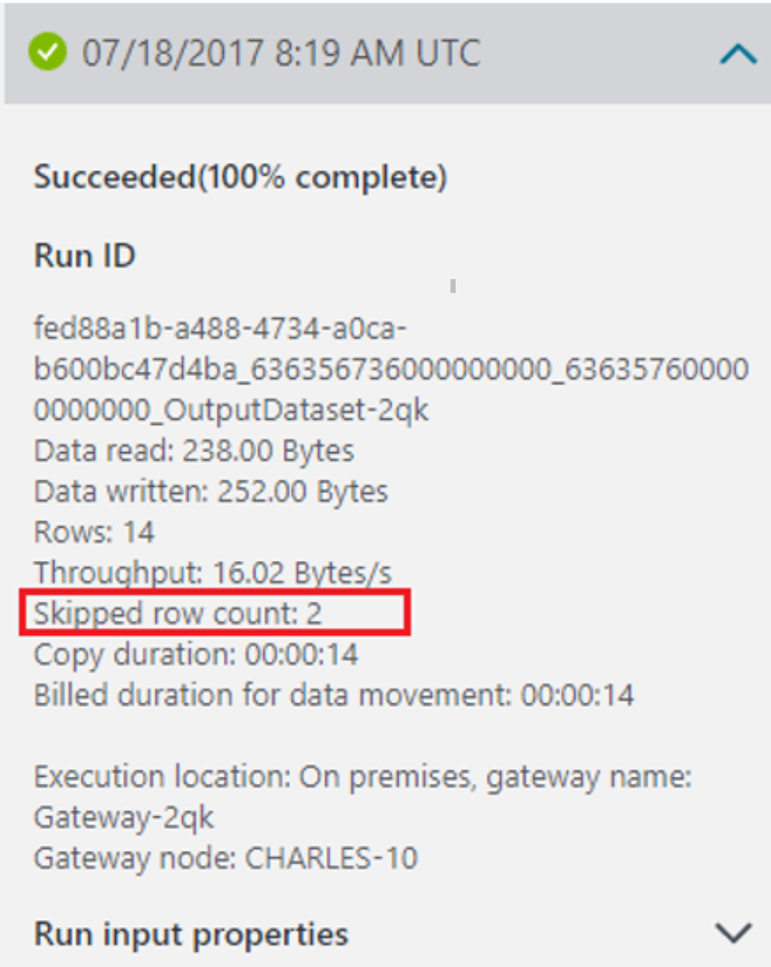
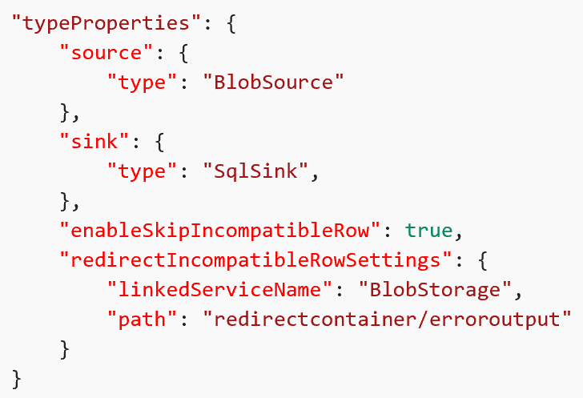
Copy Activity fault tolerance - skip incompatible rows
Abort and fail the copy activity upon encountering incompatible data
Continue copying all the data by skipping those incompatible rows
Log the incompatible rows in Azure Blob so you can examine the cause for failure
Supported scenarios
Data type incompatibility between source and sink native types
Number of columns mismatch between source and sink
Primary key violation when writing to relational database
Notes:
With Copy Activity, you have different options to deal with incompatible rows when copying data between source and sink data stores. You can choose to either abort and fail the copy activity upon encountering incompatible data (default behavior), or continue copying all the data by skipping those incompatible rows. Additionally, you also have the option to log the incompatible rows in Azure Blob so you can examine the cause for failure, fix the data on the data source and retry.+
Supported scenarios
Currently, copy activity supports detecting, skipping, and logging the following incompatible situation during copy:+
Data type incompatibility between source and sink native types
Example: to copy from CSV file in Azure Blob to Azure SQL Database, and the schema defined in Azure SQL Database has three INT type columns. Then the rows with numeric data (for example 123,456,789) in source CSV file are copied successfully, while the rows containing non-numeric value (for example 123,456,abc) are skipped as incompatible rows.
Number of columns mismatch between source and sink
Example: to copy from CSV file in Azure Blob to Azure SQL Database, and the schema defined in SQL Azure has six columns. Then the rows containing six columns in source CSV file are copied successfully, while the rows with other number of columns are skipped as incompatible rows.
Primary key violation when writing to relational database
Example: to copy from SQL Server to Azure SQL Database, there is a Primary Key defined in sink Azure SQL Database, but no such a Primary Key defined in source SQL Server. The duplicated rows that can exist in source are not allowed when writing into sink. Copy activity copies only the first row into sink and skips the second or more rows with duplicated primary key value from source to sink.

Slide 28
Azure Data Factory - Security considerations for data movement
Azure Data Factory itself does not store any data except for linked service credentials for cloud data stores, which are encrypted using certificates.
Data movement using Azure Data Factory has been certified for:
HIPAA/HITECH
ISO/IEC 27001
ISO/IEC 27018
CSA STAR

Slide 29
Cloud scenarios
Securing data store credentials
Azure Data Factory protects your data store credentials by encrypting them by using certificates managed by Microsoft.
Data encryption in transit
If the cloud data store supports HTTPS or TLS, all data transfers between data movement services in Data Factory and a cloud data store are via secure channel HTTPS or TLS.
Data encryption at rest
Azure SQL Data Warehouse: Transparent Data Encryption (TDE) Real-time encryption and decryption of your data at rest.
Azure SQL Database: Transparent Data Encryption (TDE)
Azure Data Lake Store: Azure Data Lake store also provides encryption for data stored in the account. Azure Blob Storage and Azure Table Storage: Azure Blob Storage and Azure Table storage supports Storage Service Encryption (SSE), which automatically encrypts your data before persisting to storage and decrypts before retrieval.
Notes:
Cloud scenarios
Securing data store credentials
Azure Data Factory protects your data store credentials by encrypting them by using certificates managed by Microsoft. These certificates are rotated every two years (which includes renewal of certificate and migration of credentials). These encrypted credentials are securely stored in an Azure Storage managed by Azure Data Factory management services. For more information about Azure Storage security, refer Azure Storage Security Overview.+
Data encryption in transit
If the cloud data store supports HTTPS or TLS, all data transfers between data movement services in Data Factory and a cloud data store are via secure channel HTTPS or TLS.+
Note
All connections to Azure SQL Database and Azure SQL Data Warehouse always require encryption (SSL/TLS) while data is in transit to and from the database. While authoring a pipeline using a JSON editor, add the encryption property and set it to true in the connection string. When you use the Copy Wizard, the wizard sets this property by default. For Azure Storage, you can use HTTPS in the connection string.+
Data encryption at rest
Some data stores support encryption of data at rest. We suggest that you enable data encryption mechanism for those data stores. +
Azure SQL Data Warehouse
Transparent Data Encryption (TDE) in Azure SQL Data Warehouse helps with protecting against the threat of malicious activity by performing real-time encryption and decryption of your data at rest. This behavior is transparent to the client. For more information, see Secure a database in SQL Data Warehouse.+
Azure SQL Database
Azure SQL Database also supports transparent data encryption (TDE), which helps with protecting against the threat of malicious activity by performing real-time encryption and decryption of the data without requiring changes to the application. This behavior is transparent to the client. For more information, see Transparent Data Encryption with Azure SQL Database. +
Azure Data Lake Store
Azure Data Lake store also provides encryption for data stored in the account. When enabled, Data Lake store automatically encrypts data before persisting and decrypts before retrieval, making it transparent to the client accessing the data. For more information, see Security in Azure Data Lake Store. +
Azure Blob Storage and Azure Table Storage
Azure Blob Storage and Azure Table storage supports Storage Service Encryption (SSE), which automatically encrypts your data before persisting to storage and decrypts before retrieval. For more information, see Azure Storage Service Encryption for Data at Rest.+
Amazon S3
Amazon S3 supports both client and server encryption of data at Rest. For more information, see Protecting Data Using Encryption. Currently, Data Factory does not support Amazon S3 inside a virtual private cloud (VPC).+
Amazon Redshift
Amazon Redshift supports cluster encryption for data at rest. For more information, see Amazon Redshift Database Encryption. Currently, Data Factory does not support Amazon Redshift inside a VPC. +
Salesforce
Salesforce supports Shield Platform Encryption that allows encryption of all files, attachments, custom fields. For more information, see Understanding the Web Server OAuth Authentication Flow.

Slide 30
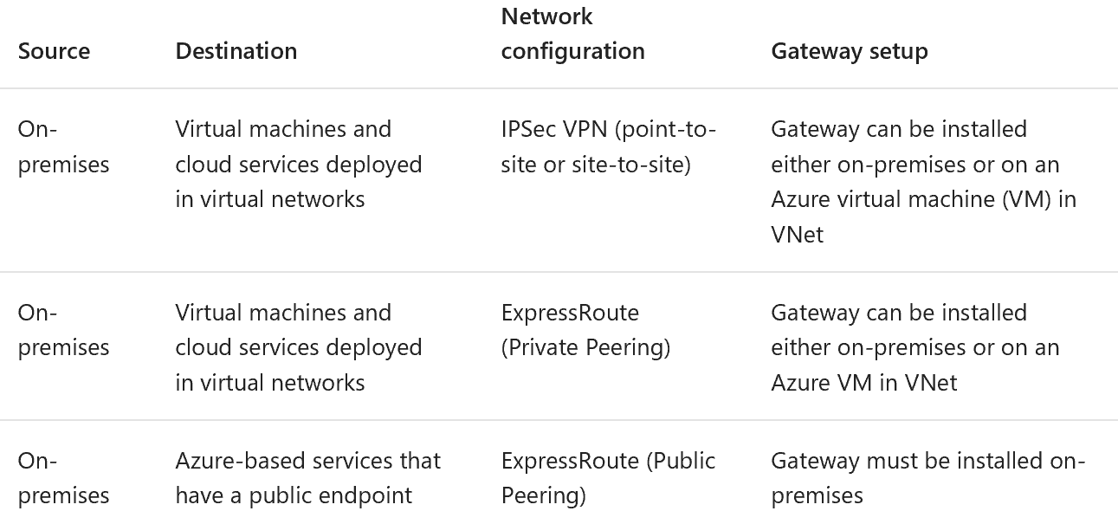
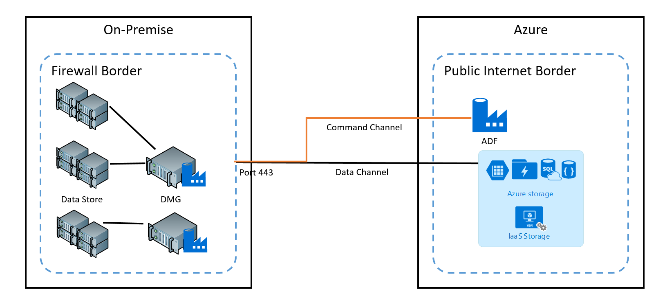
Hybrid Scenarios (using Data Management Gateway)
Hybrid scenarios require Data Management Gateway to be installed in an on-premises network or inside a virtual network (Azure) or a virtual private cloud (Amazon). The gateway must be able to access the local data stores. The credentials for your on-premises data stores are stored locally (not in the cloud).
Encryption in transit
Notes:
Hybrid scenarios require Data Management Gateway to be installed in an on-premises network or inside a virtual network (Azure) or a virtual private cloud (Amazon). The gateway must be able to access the local data stores. For more information about the gateway, see Data Management Gateway.
The command channel allows communication between data movement services in Data Factory and Data Management Gateway. The communication contains information related to the activity. The data channel is used for transferring data between on-premises data stores and cloud data stores. +
On-premises data store credentials
The credentials for your on-premises data stores are stored locally (not in the cloud). They can be set in three different ways. +
Using plain-text (less secure) via HTTPS from Azure Portal/ Copy Wizard. The credentials are passed in plain-text to the on-premises gateway.
Using JavaScript Cryptography library from Copy Wizard.
Using click-once based credentials manager app. The click-once application executes on the on-premises machine that has access to the gateway and sets credentials for the data store. This option and the next one are the most secure options. The credential manager app, by default, uses the port 8050 on the machine with gateway for secure communication.
Use New-AzureRmDataFactoryEncryptValue PowerShell cmdlet to encrypt credentials. The cmdlet uses the certificate that gateway is configured to use to encrypt the credentials. You can use the encrypted credentials returned by this cmdlet and add it to EncryptedCredential element of the connectionString in the JSON file that you use with the New-AzureRmDataFactoryLinkedService cmdlet or in the JSON snippet in the Data Factory Editor in the portal. This option and the click-once application are the most secure options.
+
JavaScript cryptography library-based encryption
You can encrypt data store credentials using JavaScript Cryptography library from the Copy Wizard. When you select this option, the Copy Wizard retrieves the public key of gateway and uses it to encrypt the data store credentials. The credentials are decrypted by the gateway machine and protected by Windows DPAPI.+
Supported browsers: IE8, IE9, IE10, IE11, Microsoft Edge, and latest Firefox, Chrome, Opera, Safari browsers. +
Click-once credentials manager app
You can launch the click-once based credential manager app from Azure portal/Copy Wizard when authoring pipelines. This application ensures that credentials are not transferred in plain text over the wire. By default, it uses the port 8050 on the machine with gateway for secure communication. If necessary, this port can be changed.
Currently, Data Management Gateway uses a single certificate. This certificate is created during the gateway installation (applies to Data Management Gateway created after November 2016 and version 2.4.xxxx.x or later). You can replace this certificate with your own SSL/TLS certificate. This certificate is used by the click-once credential manager application to securely connect to the gateway machine for setting data store credentials. It stores data store credentials securely on-premises by using the Windows DPAPI on the machine with gateway.

Slide 31
Data Management Gateway
The Data Management Gateway is a client agent that you must install in your on-premises environment to copy data between cloud and on-premises data stores.
Data Management Gateway provides the following capabilities:
Model on-premises data sources and cloud data sources within the same data factory and move data.
Have a single pane of glass for monitoring and management with visibility into gateway status from the Data Factory blade.
Manage access to on-premises data sources securely.
No changes required to corporate firewall. Gateway only makes outbound HTTP-based connections to open internet.
Encrypt credentials for your on-premises data stores with your certificate.
Move data efficiently – data is transferred in parallel, resilient to intermittent network issues with auto retry logic.

Slide 32
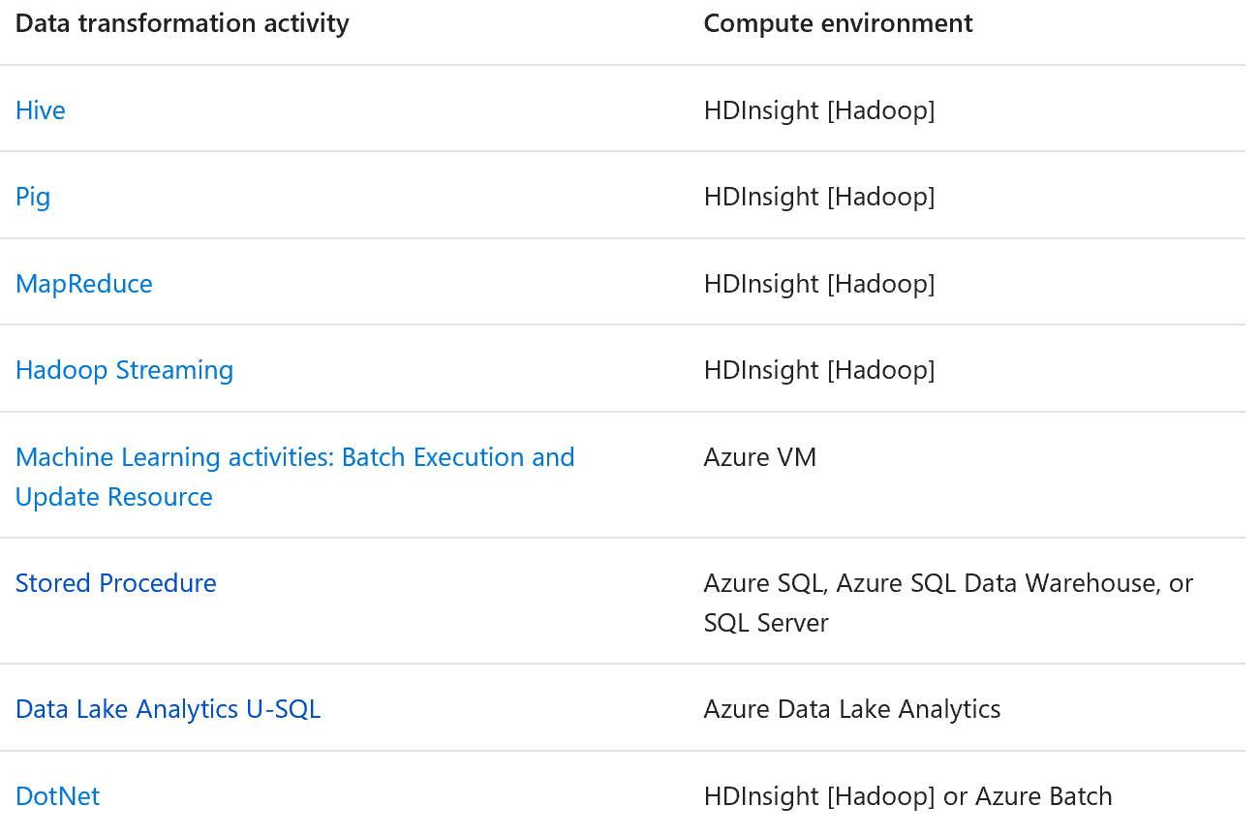
Transform data in Azure Data Factory
Azure Data Factory supports the following data transformation activities and the compute environments for the activities. The transformation activities can be added to pipelines either individually or chained with another activity.

Slide 33
Compute environments
You create a linked service for the compute environment and then use the linked service when defining a transformation activity.
There are two types of compute environments supported by Data Factory.
On-Demand: In this case, the computing environment is fully managed by Data Factory. It is automatically created by the Data Factory service before a job is submitted to process data and removed when the job is completed. You can configure and control granular settings of the on-demand compute environment for job execution, cluster management, and bootstrapping actions.
Bring Your Own: In this case, you can register your own computing environment (for example HDInsight cluster) as a linked service in Data Factory. The computing environment is managed by you and the Data Factory service uses it to execute the activities.

Slide 34
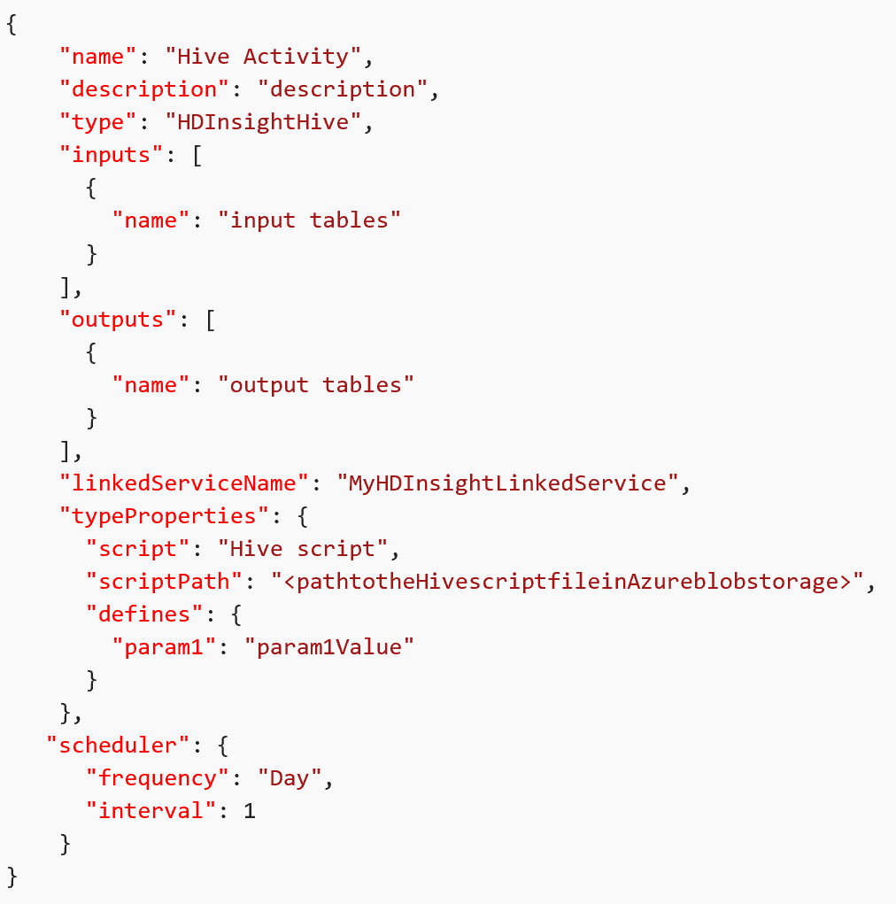
Data Factory and HDInsight
The HDInsight Hive activity in a Data Factory pipeline executes Hive queries on your own or on-demand Windows/Linux-based HDInsight cluster.
Notes:
https://docs.microsoft.com/en-us/azure/data-factory/data-factory-hive-activity

Slide 35
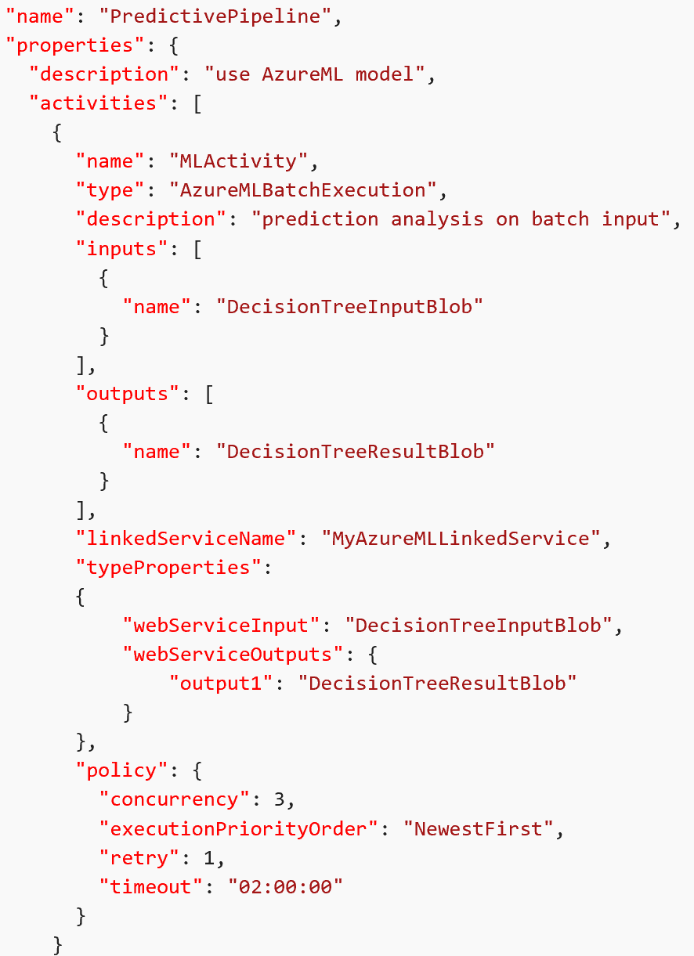
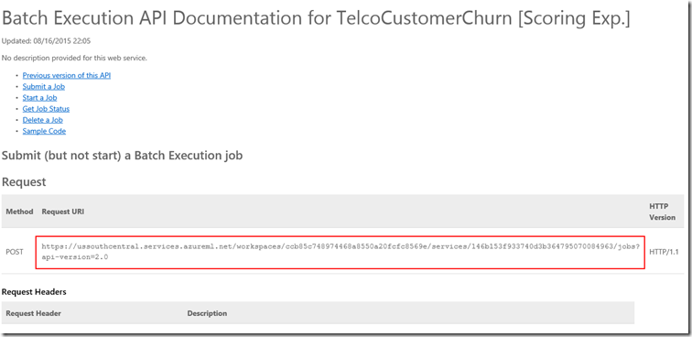
Machine Learning and Azure Data Factory
Azure Data Factory enables you to easily create pipelines that use a published Azure Machine Learning web service for predictive analytics. Using the Batch Execution Activity in an Azure Data Factory pipeline, you can invoke an Azure ML web service to make predictions on the data in batch.
You can retrain an Azure ML model from a Data Factory pipeline by doing the following steps:
Publish the training experiment (not predictive experiment) as a web service.
Use the Azure ML Batch Execution Activity to invoke the web service for the training experiment.
Notes:
https://docs.microsoft.com/en-us/azure/data-factory/data-factory-azure-ml-batch-execution-activity

Slide 36
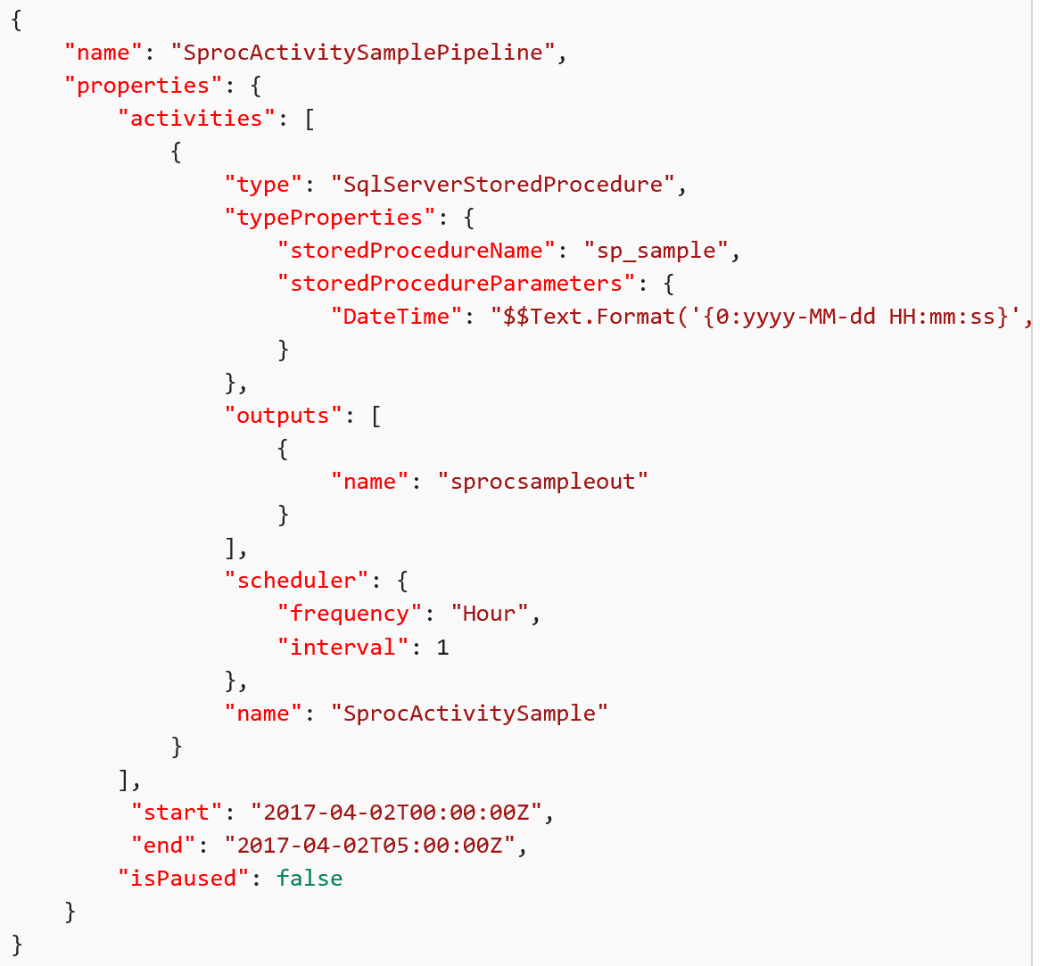
SQL Server Stored Procedure Activity
You can use the Stored Procedure Activity to invoke a stored procedure in one of the following data stores in your enterprise or on an Azure virtual machine (VM):
Azure SQL Database
Azure SQL Data Warehouse
SQL Server Database. If you are using SQL Server, install Data Management
Gateway on the same machine that hosts the database or on a separate machine
that has access to the database.

Slide 37
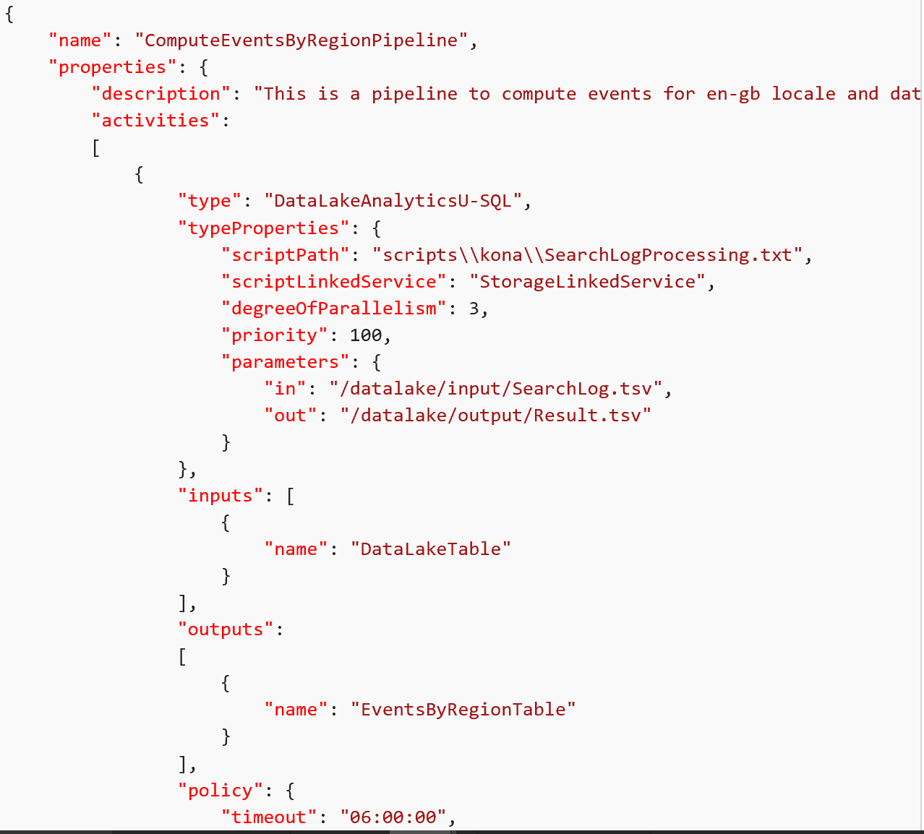
Data Lake Analytics and Data Factory
Data Lake Analytics U-SQL Activity runs a U-SQL script on an Azure Data Lake Analytics cluster.
The following JSON snippet defines a pipeline with a Data Lake Analytics U-SQL Activity. The activity definition has a reference to the Azure Data Lake Analytics linked service
Notes:
https://docs.microsoft.com/en-us/azure/data-factory/data-factory-usql-activity

Slide 38
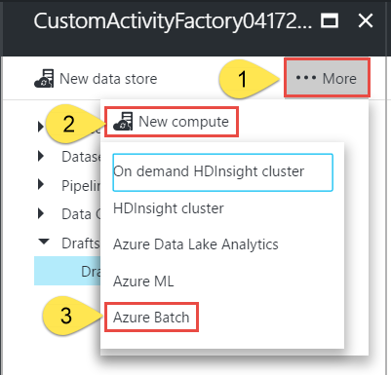
.NET custom activity and Data Factory
If you need to transform data in a way that is not supported by Data Factory, you can create a custom activity with your own data processing logic and use the activity in the pipeline. You can configure the custom .NET activity to run using either an Azure Batch service or an Azure HDInsight cluster.
You can configure a custom activity to run on an Azure Batch pool of virtual machines or a Windows-based Azure HDInsight cluster. When using Azure Batch, you can use only an existing Azure Batch pool. Whereas, when using HDInsight, you can use an existing HDInsight cluster or a cluster that is automatically created for you on-demand at runtime
Notes:
https://docs.microsoft.com/en-us/azure/data-factory/data-factory-use-custom-activities

Slide 39
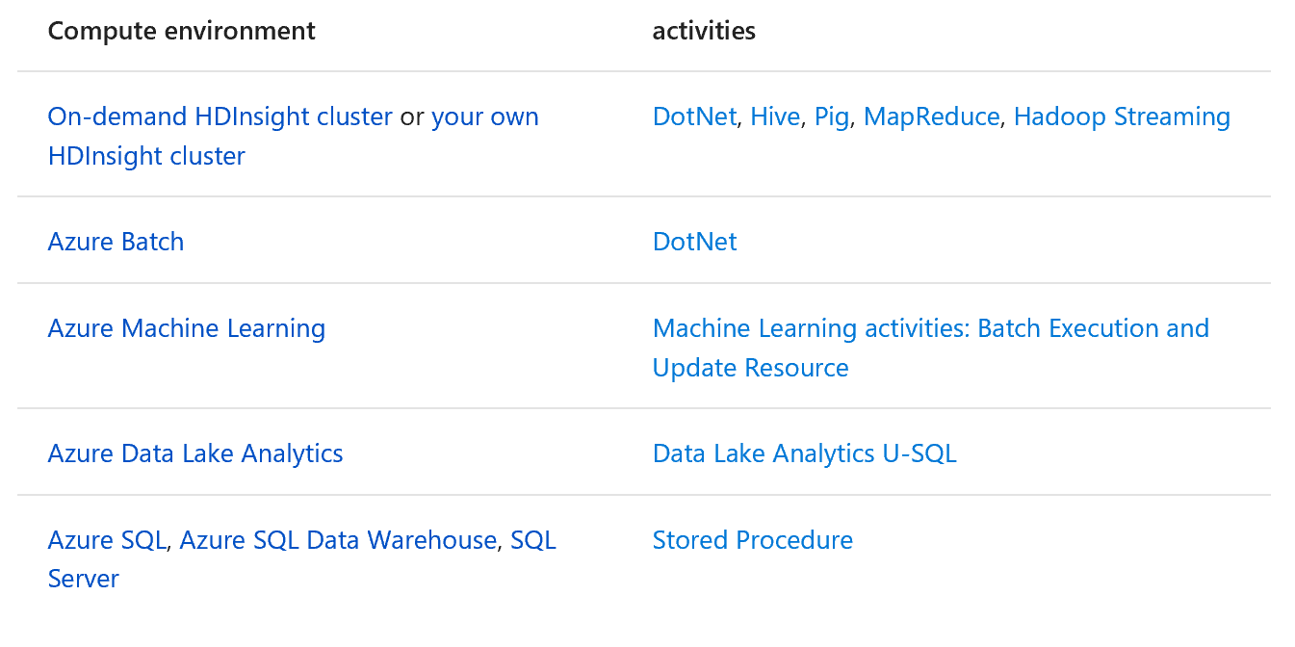
Compute environments supported by Azure Data Factory
The following table provides a list of compute environments supported by Data Factory and the activities that can run on them.
Notes:
https://docs.microsoft.com/en-us/azure/data-factory/data-factory-compute-linked-services

Slide 40
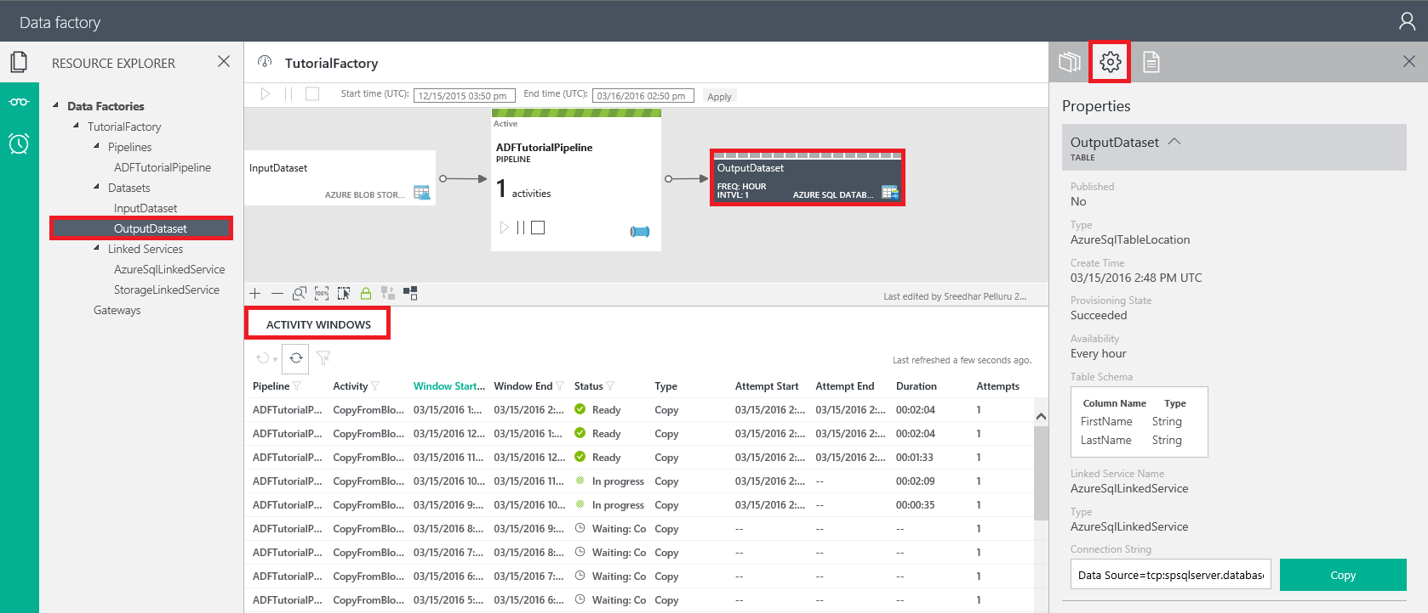
Monitor and manage Azure Data Factory pipelines by using the Monitoring and Management app
The Resource Explorer tree view in the left pane.
The Diagram View at the top in the middle pane.
The Activity Windows list at the bottom in the middle pane.
The Properties, Activity Window Explorer, and Script tabs in the right pane.

Slide 41
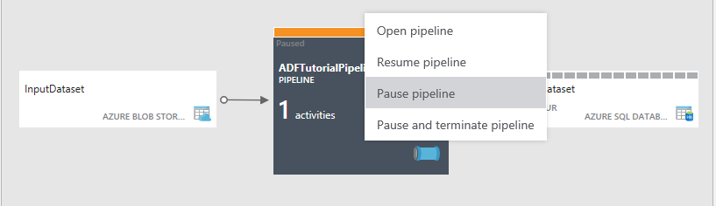
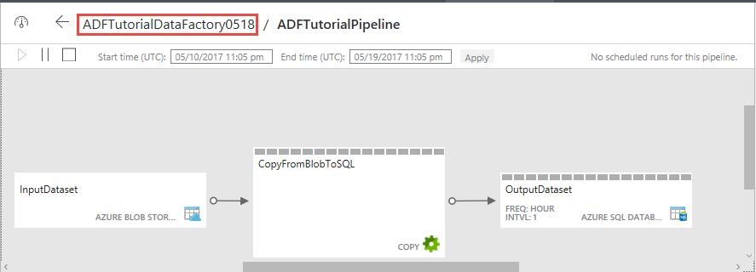
You can also right-click a pipeline and select options to suspend, resume, or terminate a pipeline.
In the opened pipeline view, you see all activities in the pipeline. In this example, there is only one activity: Copy Activity.

Slide 42
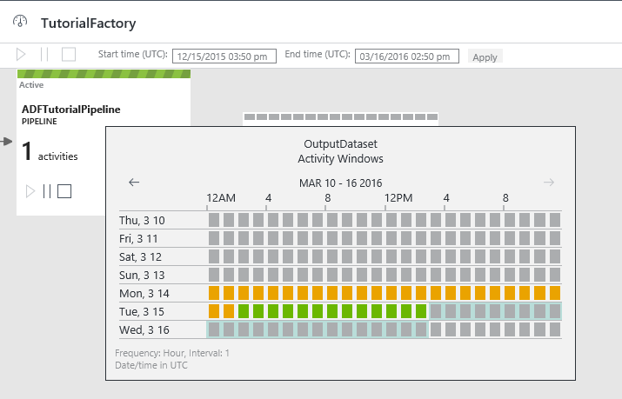
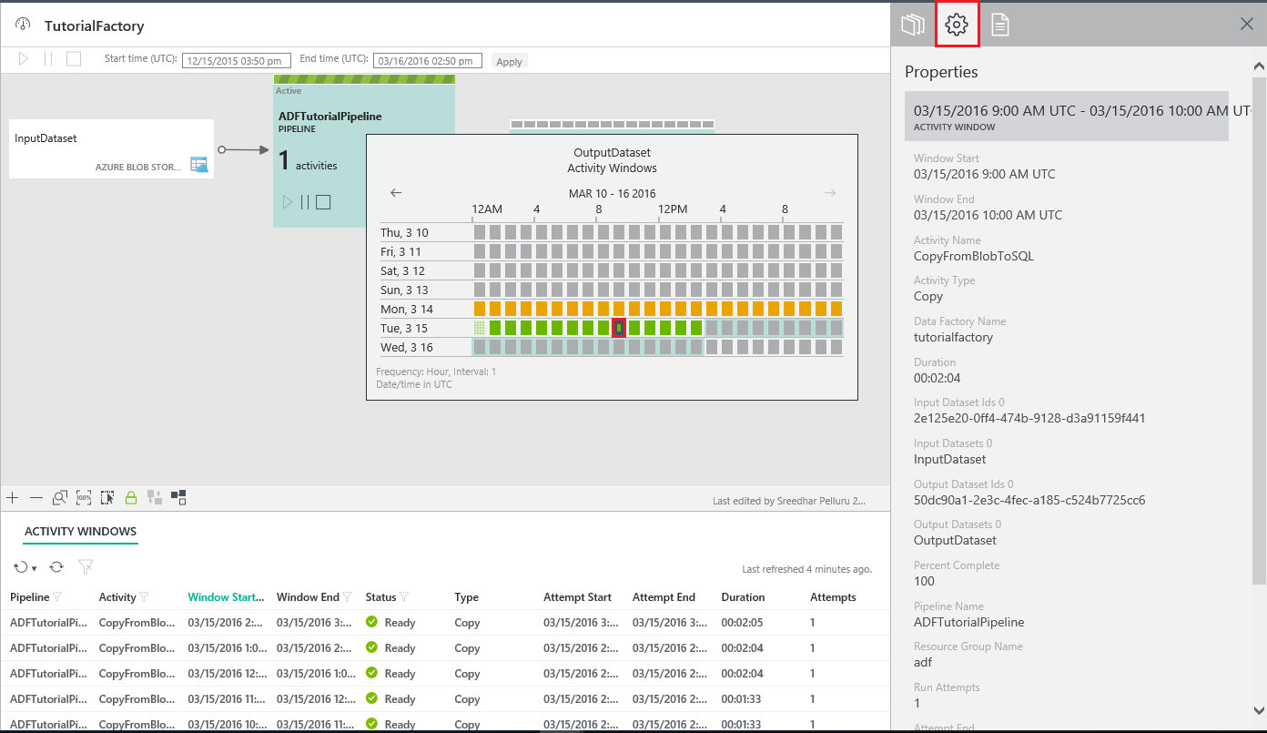
In the pipeline view, when you select an output dataset or when you move your mouse over the output dataset, you see the Activity Windows pop-up window for that dataset.
You can click an activity window to see details for it in the Properties window in the right pane.

Slide 43
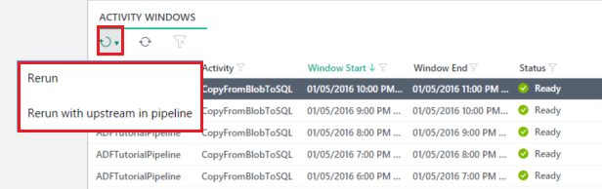
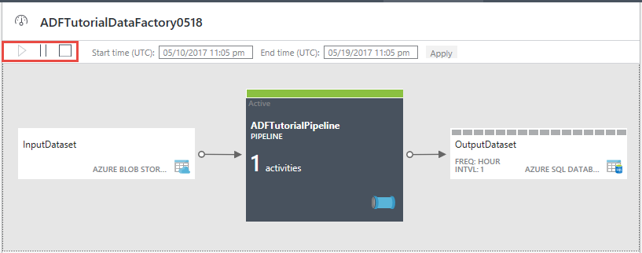
Perform batch actions
You can select multiple activity windows in the list and rerun them at the same time. You might want to filter activity windows based on the status (for example: Failed)--and then rerun the failed activity windows after correcting the issue that causes the activity windows to fail.
You can multiselect two or more pipelines by using the Ctrl key. You can use the command bar buttons (which are highlighted in the red rectangle in the following image) to pause/resume them.

Slide 44
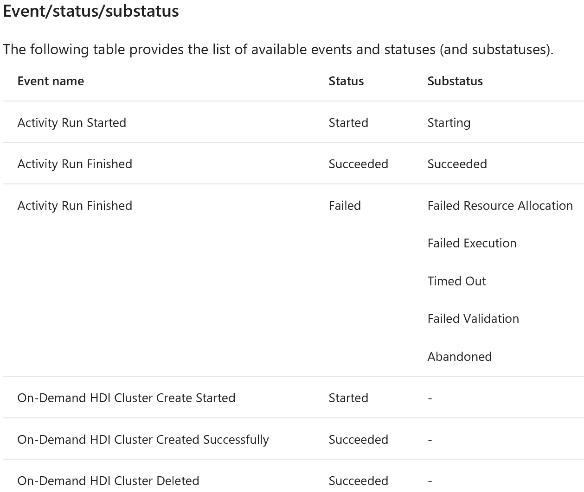
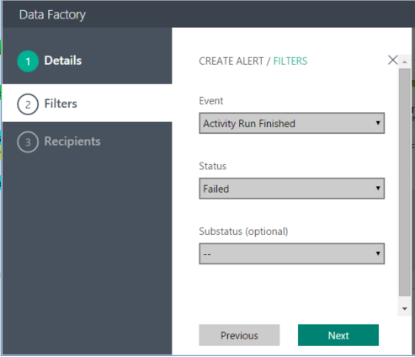
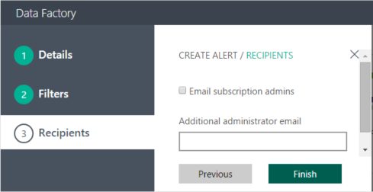
Create alerts
The Alerts page lets you create an alert and view/edit/delete existing alerts. You can also disable/enable an alert.
Notes:
To create an alert
1. Click Add Alert to add an alert. You see the Details page.
2. Specify the Name and Description for the alert, and click Next. You should see the Filters page.
3. Select the event, status, and substatus (optional) that you want to create a Data Factory service alert for, and click Next. You should see the Recipients page.
4. Select the Email subscription admins option and/or enter an additional administrator email, and click Finish. You should see the alert in the list.

Slide 45
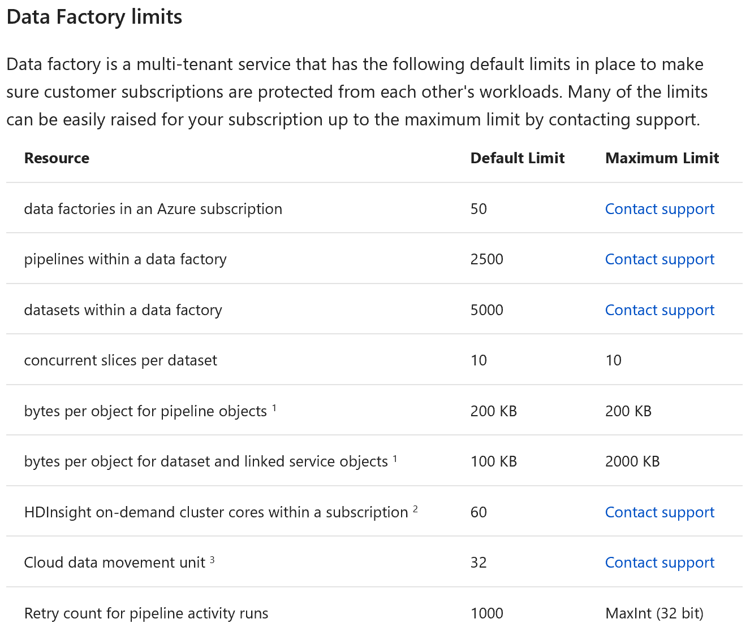
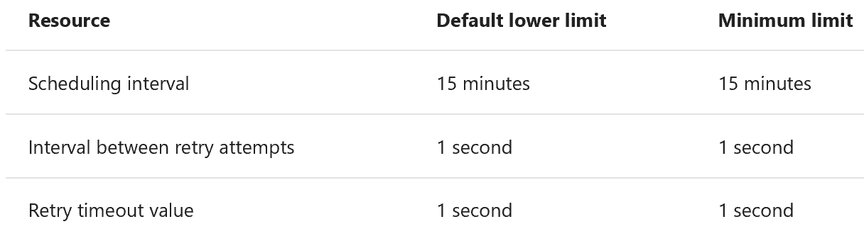
Data Factory Limits

Slide 46
Data Factory Developer Tools
Azure Portal
Create, Edit, Delete all objects. Textual
Visual Studio
Integrated in VS Project
Powershell
Via Cmdlets https://docs.microsoft.com/en-us/powershell/module/azurerm.datafactories/?view=azurermps-4.2.0
Azure Resource Manager Template
Rest API
.NET API
Source sample on Github https://github.com/Azure/Azure-DataFactory

Slide 47
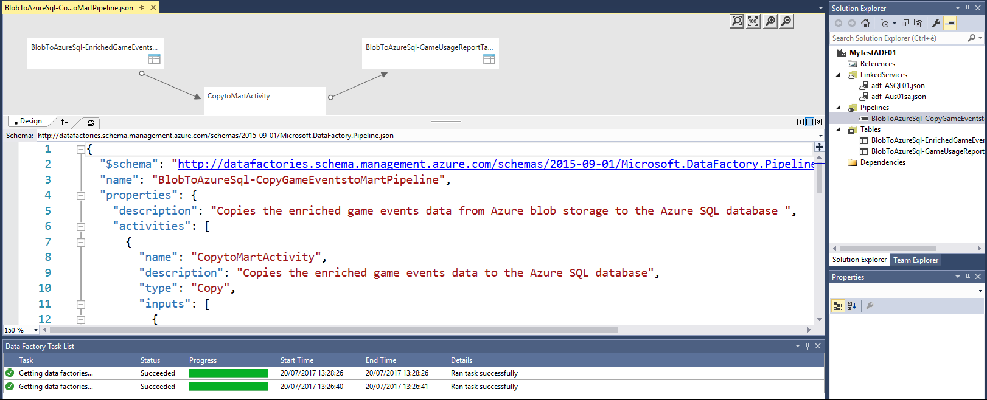
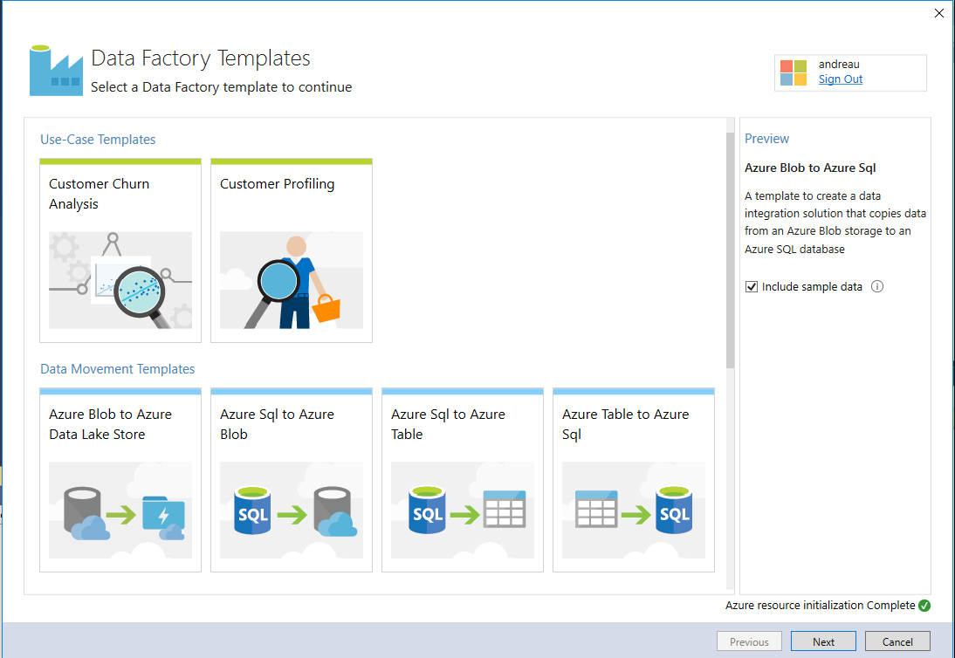
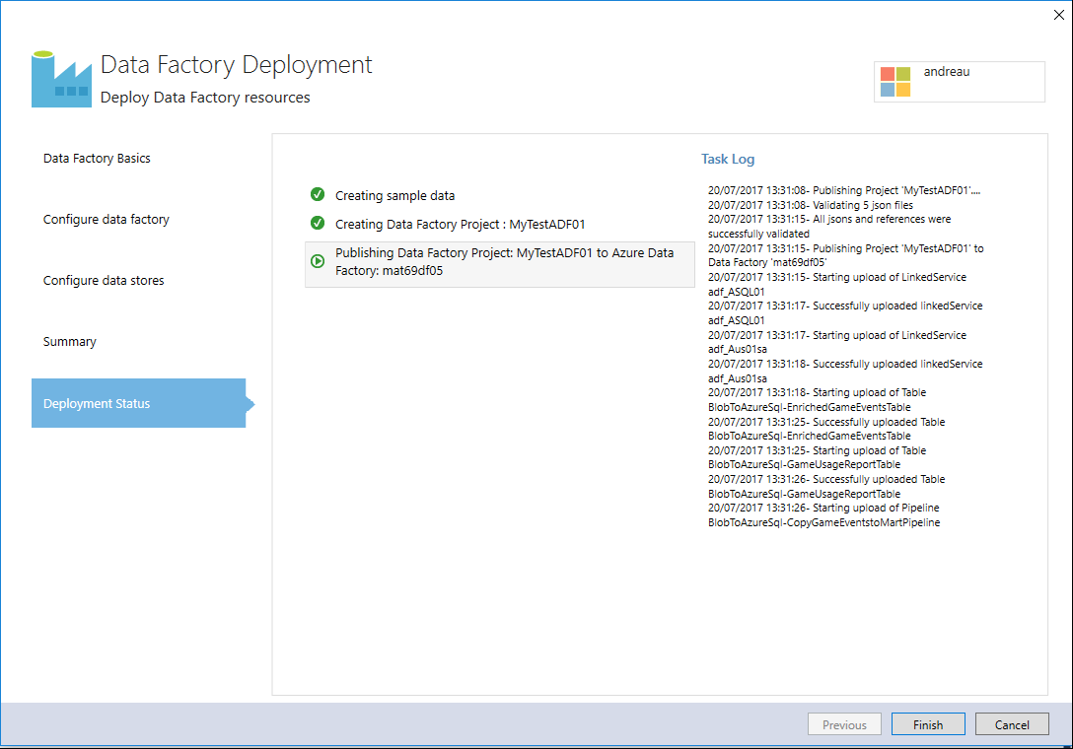
Data Factory Developer Tools: Visual Studio
Visual Studio
Download Azure DataFactory Tools https://marketplace.visualstudio.com/items?itemName=AzureDataFactory.MicrosoftAzureDataFactoryToolsforVisualStudio2015
Template based authoring
Integration with Solution Explorer
Integration with Diagram View
JSON editing with schema validation

Slide 48
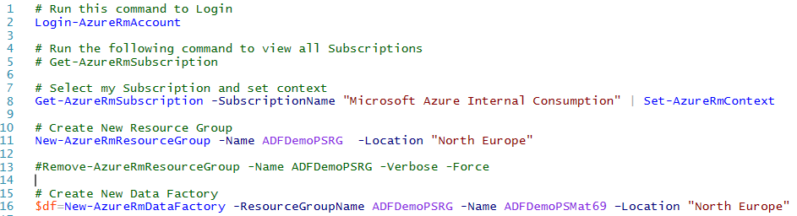
Data Factory Developer Tools: Powershell
Powershell
Author Data Factory
Get/New/Remove AzureRMDataFactory
Get/New/Remove AzureRmDataFactoryLinkedService
Get/New/Remove AzureRmDataFactoryDataset
Get/New/Remove AzureRmDataFactoryPipeline
Control Pipeline
Resume-AzureRmDataFactoryPipeline
Suspend-AzureRmDataFactoryPipeline
Cmdlets references https://docs.microsoft.com/en-us/powershell/module/azurerm.datafactories/?view=azurermps-4.2.0

Slide 49
Demo
Copy data from Blob Storage to SQL Database using Data Factory
https://docs.microsoft.com/en-us/azure/data-factory/data-factory-copy-data-from-azure-blob-storage-to-sql-database
Notes:
https://docs.microsoft.com/en-us/azure/data-factory/data-factory-copy-data-from-azure-blob-storage-to-sql-database

Slide 50
Demo
Build your first pipeline to transform data using Hadoop cluster
https://docs.microsoft.com/en-us/azure/data-factory/data-factory-build-your-first-pipeline
Notes:
https://docs.microsoft.com/en-us/azure/data-factory/data-factory-build-your-first-pipeline

Slide 51
Demo
Move data between on-premises sources and the cloud with Data Management Gateway
https://docs.microsoft.com/en-us/azure/data-factory/data-factory-move-data-between-onprem-and-cloud
Notes:
https://docs.microsoft.com/en-us/azure/data-factory/data-factory-move-data-between-onprem-and-cloud

Slide 52
Q&A

Slide 53

Thank You for attending today’s session!!
Please feel free to reach out with any questions or concerns.
© 2016 Microsoft Corporation. All rights reserved.

Slide 54
Appendix

Slide 55
Team Data Science Process walkthroughs
Data Science using Python with Spark on Azure
Data Science using Scala with Spark on Azure
Use HDInsight Hadoop clusters
Use Azure HDInsight Hadoop Clusters on a 1-TB dataset
Use Azure Data Lake Store and Analytics
Use SQL Data Warehouse
Use SQL Server
Use R with SQL Server R Services
Use T-SQL with SQL Server R Services
Use T-SQL with SQL Server Python Services
https://docs.microsoft.com/en-us/azure/machine-learning/data-science-process-walkthroughs
Notes:
https://docs.microsoft.com/en-us/azure/machine-learning/data-science-process-walkthroughs

